Slide 1
Enrollment Management:
Reignite
Kapi‘olani Community College, Fall 2017

Slide 2
Where we have been.
System Enrollment Management Plan
UHCC Enrollment Management Plan
common template, common language
KCC Enrollment Management Plan 2015-2021
Working super hard.
Trying various initiatives.
Making a difference where we can.
Working in Silos.

Slide 4
Campaigns – Campus Based
Non-Credit Registration Inquiries Follow up
First Year Experience working with specific academic departments to open sections
Various Summer Bridge Programs - 3 Pasefika Pipeline, TRiO, Lunalilo Scholars, Kapo‘oloku Peer Mentors
Marketing Efforts & Alignment
Reach Out Campaign
Calling Campaign, students registered for Spring, at 70% completion and not registered for Fall, 229 students
Campaign for continuing students not yet registered for Fall without holds on account, roughly 1200+
Continued follow up with 100% completers who did not petition to graduate
Kūloa‘a Pilot Project, Title III – 119 DS hold for Native Hawaiians, 77 still to make a payment, 13 owe less than $522

Slide 5
UHCC System Based Efforts
Integrated Communication for Recruitment and Retention Calendar
Time is Running Out postcard x 2 – 1,181
Continuing students, not registered
Continuing students, purged, holds, not registered [after Purge, July 21st]
Starfish x 2
Custom email message via Starfish for students with Holds – 1482, 89 cleared & registered holds
Custom email message via Starfish for students who are new, not yet registered – 1,851

Slide 6
Where we are.
OVERALL:
4927: Applications were processed (touched by someone in Admissions)
3647: Admitted and Registered with Kapiolani as their home campus [53% vs. 74%]
1088: Registered for 12 credits or more
1492: Freshman-Classified & First Time
755: Transfer students
434: Returning students
569: Incomplete or Pending (students applied but didn’t submit all documents to be fully admitted)
27: Had no-status (mostly International students)
99: Accepted by rollover
231: Applied but were already accepted at another campus so was not accepted to Kapiolani
Remember
Numbers are numbers, but also numbers are our students.
A family.
A future.
A dreamer.
Our future.
Our community.

Slide 7
Total enrollment keeps going down by ~300 a year

Slide 8
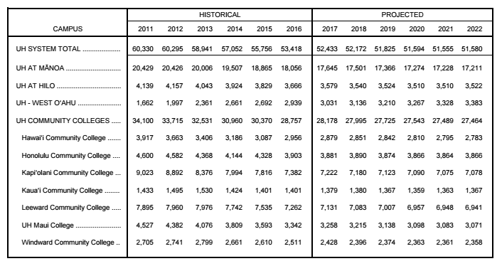
We are on target...

Slide 9
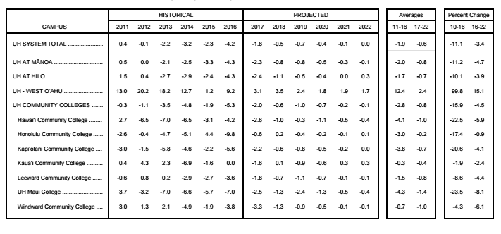

Slide 10
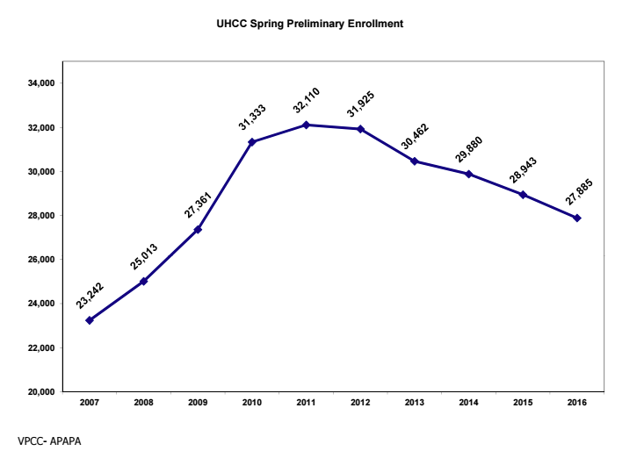
Is there good news?

Slide 11
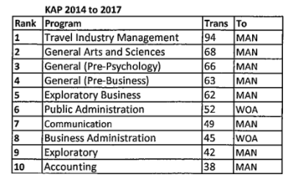
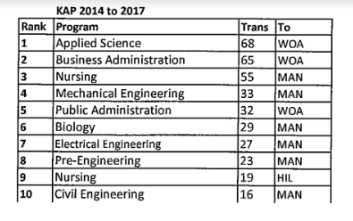
Top Transfer Patterns
Liberal Arts Transfer Associate in Science Transfer

Slide 12
Real System Targets

Slide 13
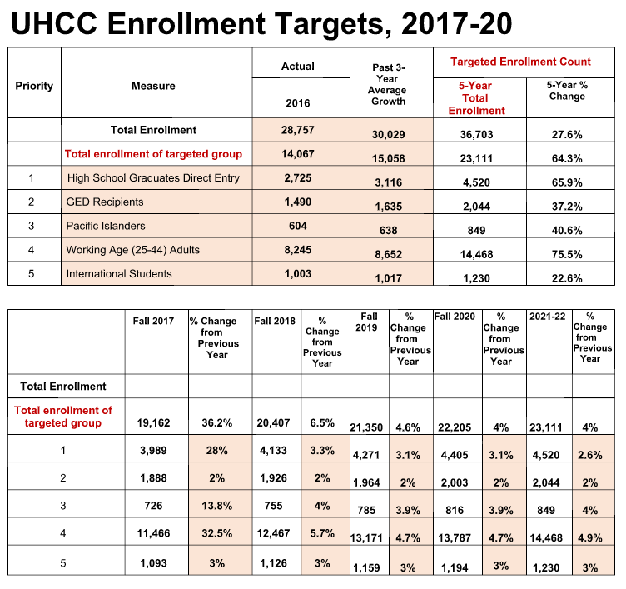
Link to Report

Slide 14
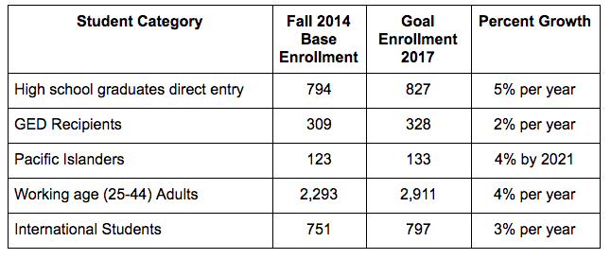
Real Goals

Slide 15
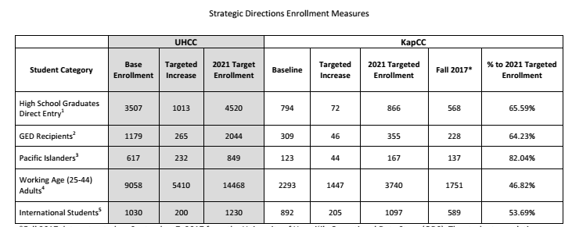

Slide 16
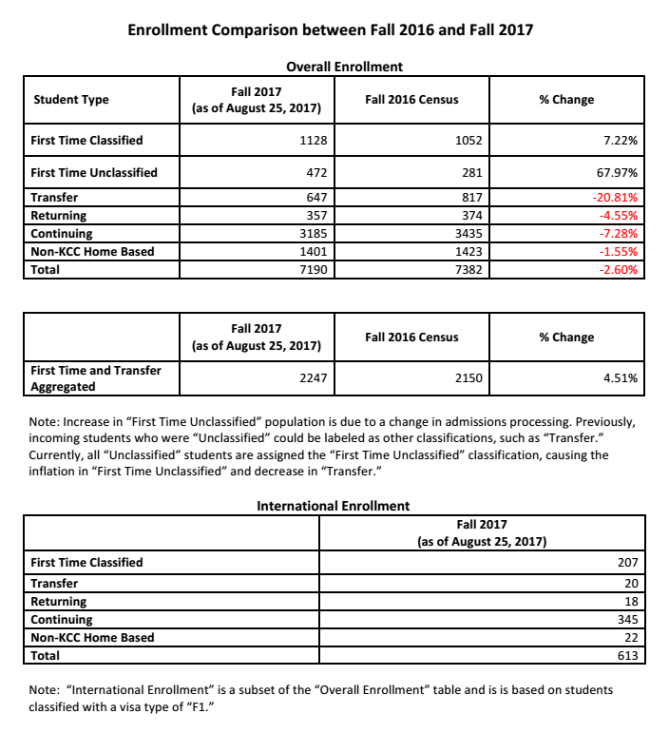

Slide 17
Where we need to go

Slide 18
Next Steps
Bring in Academic Affairs
Campus Buy In
Keep it Simple
Three simple steps.

Slide 19
Together we can
create the change.
Questions?

