Slide 1
Critical Design Review USLI
Windward Community College
University of Hawaii
2012-2013

Slide 2
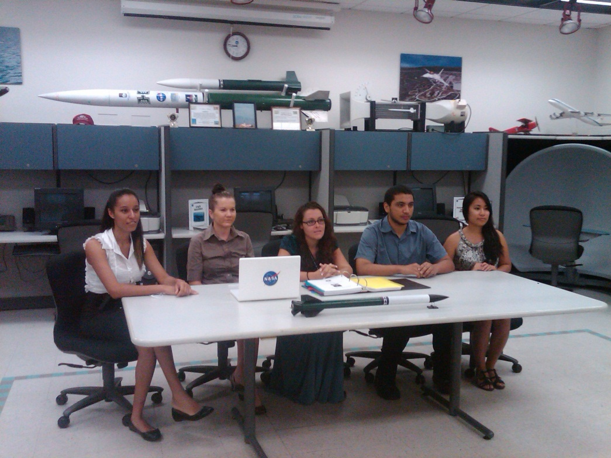
Rocket: The Green Machine Payload: Wilfred
Team Official: Dr. Jacob Hudson
Ke Kime Kao Lele Keu Loa
Kristi Ross
Lyra Hancock
Warren Mamizuka
Ada Garcia
Kristin Barsoumian

Slide 3
Rocket Design Criteria
Build a Rocket to be launched to an altitude of 5280 ft. (1 mile)
Rocket must carry a scientific payload
Rocket must return safely

Slide 4
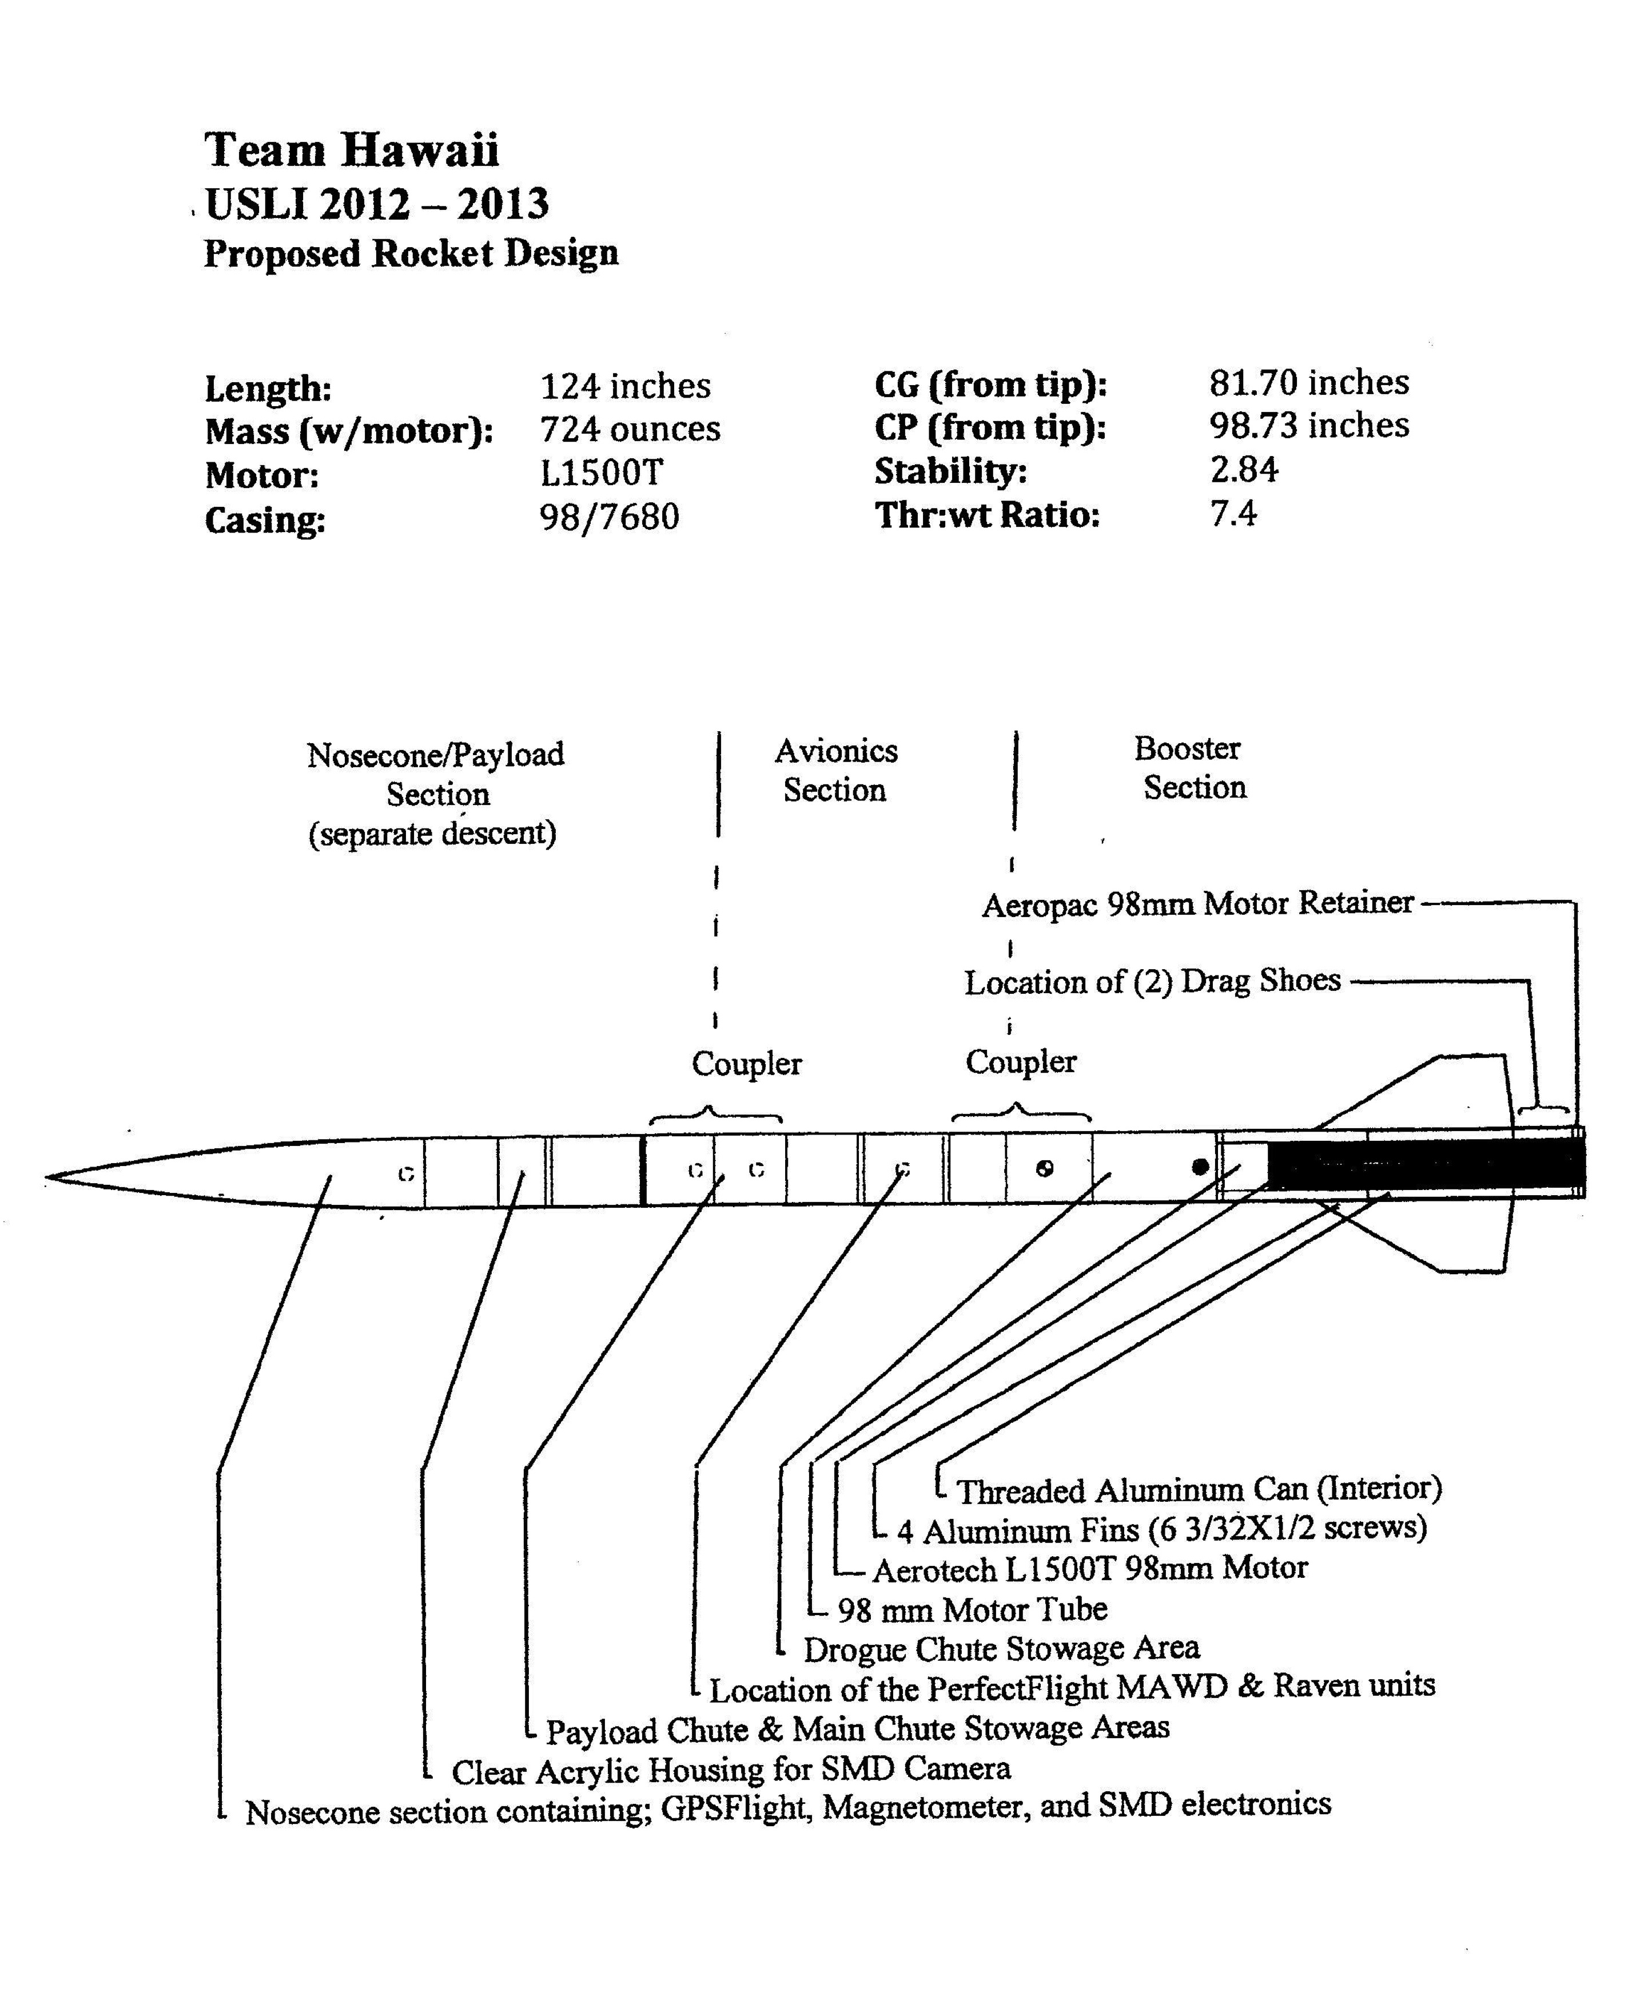
The Green Machine

Slide 5
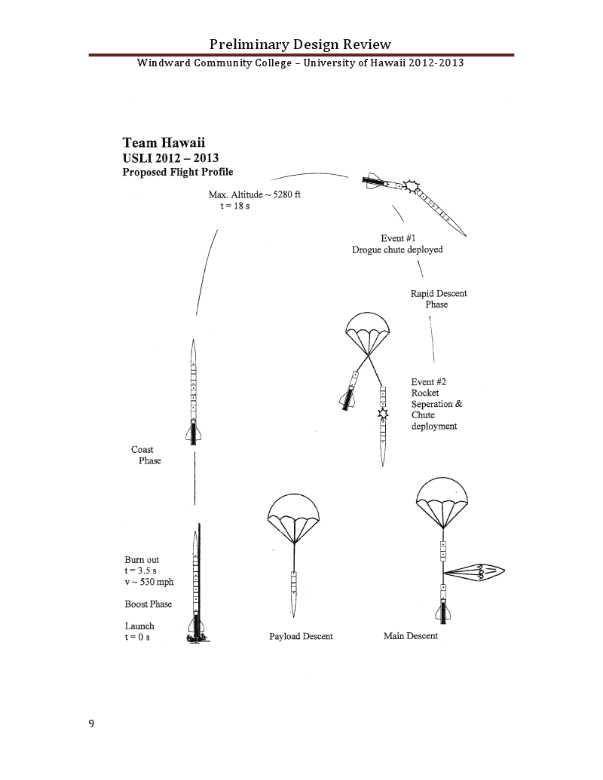
Flight Profile

Slide 6
Rocket Design Details
Length: 124 in.
Diameter: 6 in.
Unloaded Weight: 496 oz.
Weight: 724 oz.
Materials: G10 Fiberglass
Recovery: Dual Deployment, Electronic
Propulsion: AEROTECH L1500T

Slide 7
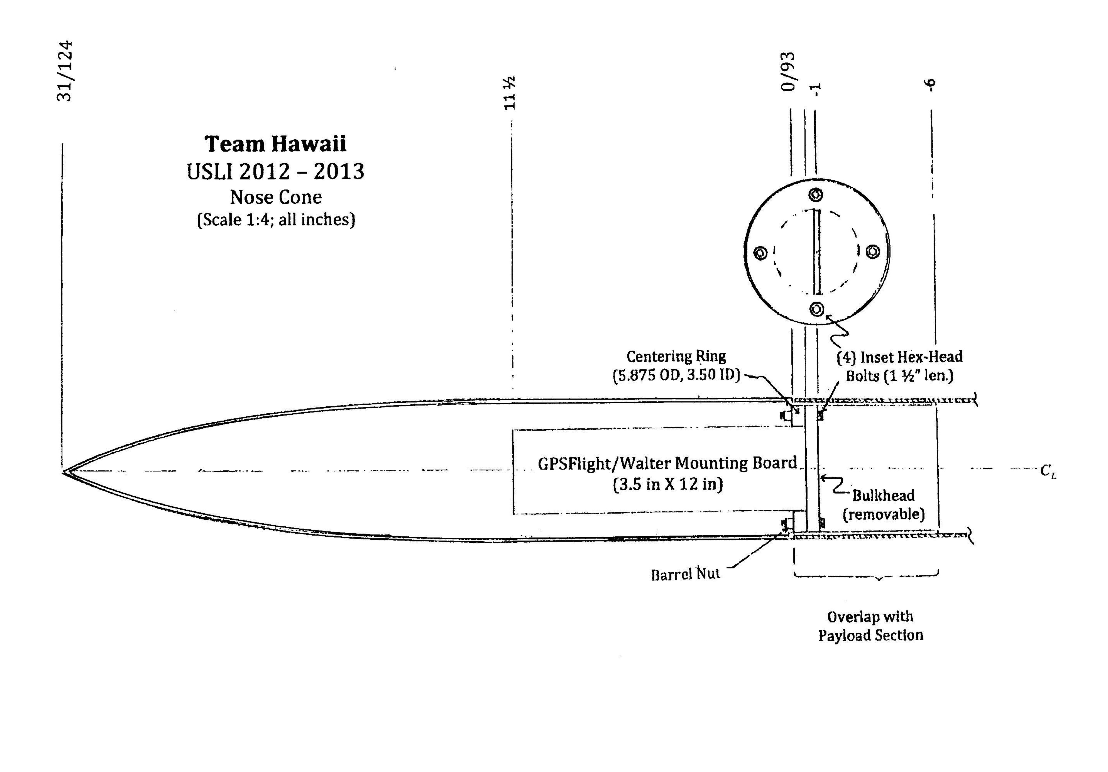

Slide 8
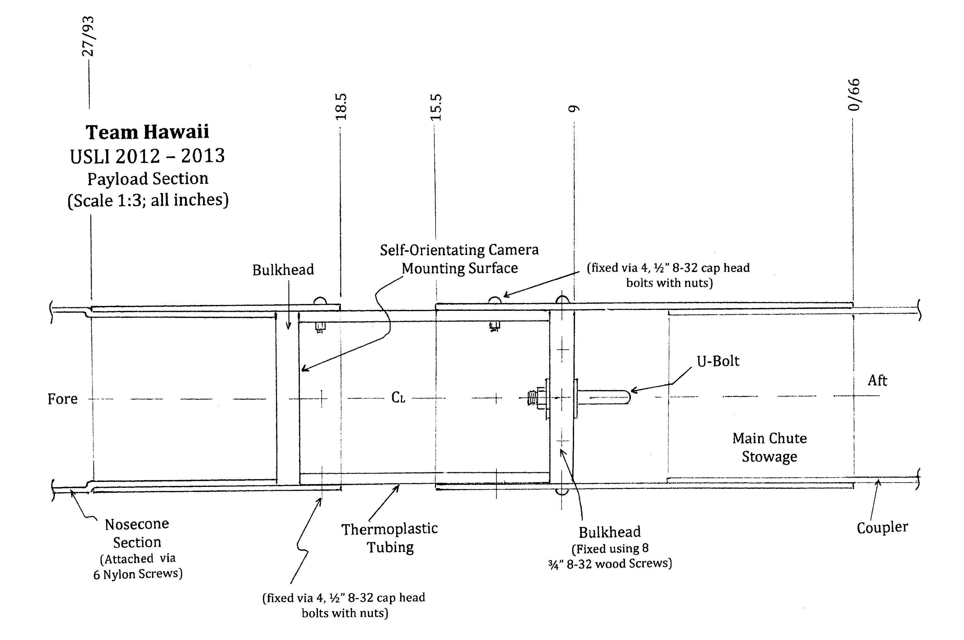

Slide 9
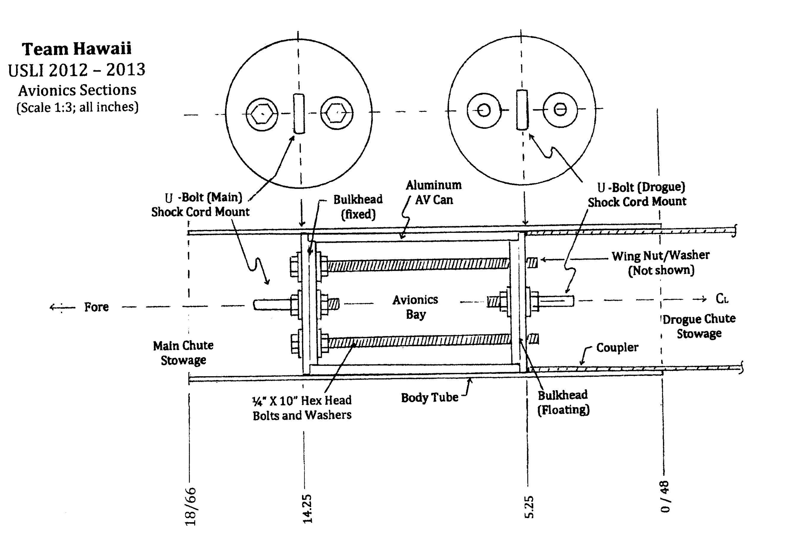

Slide 10
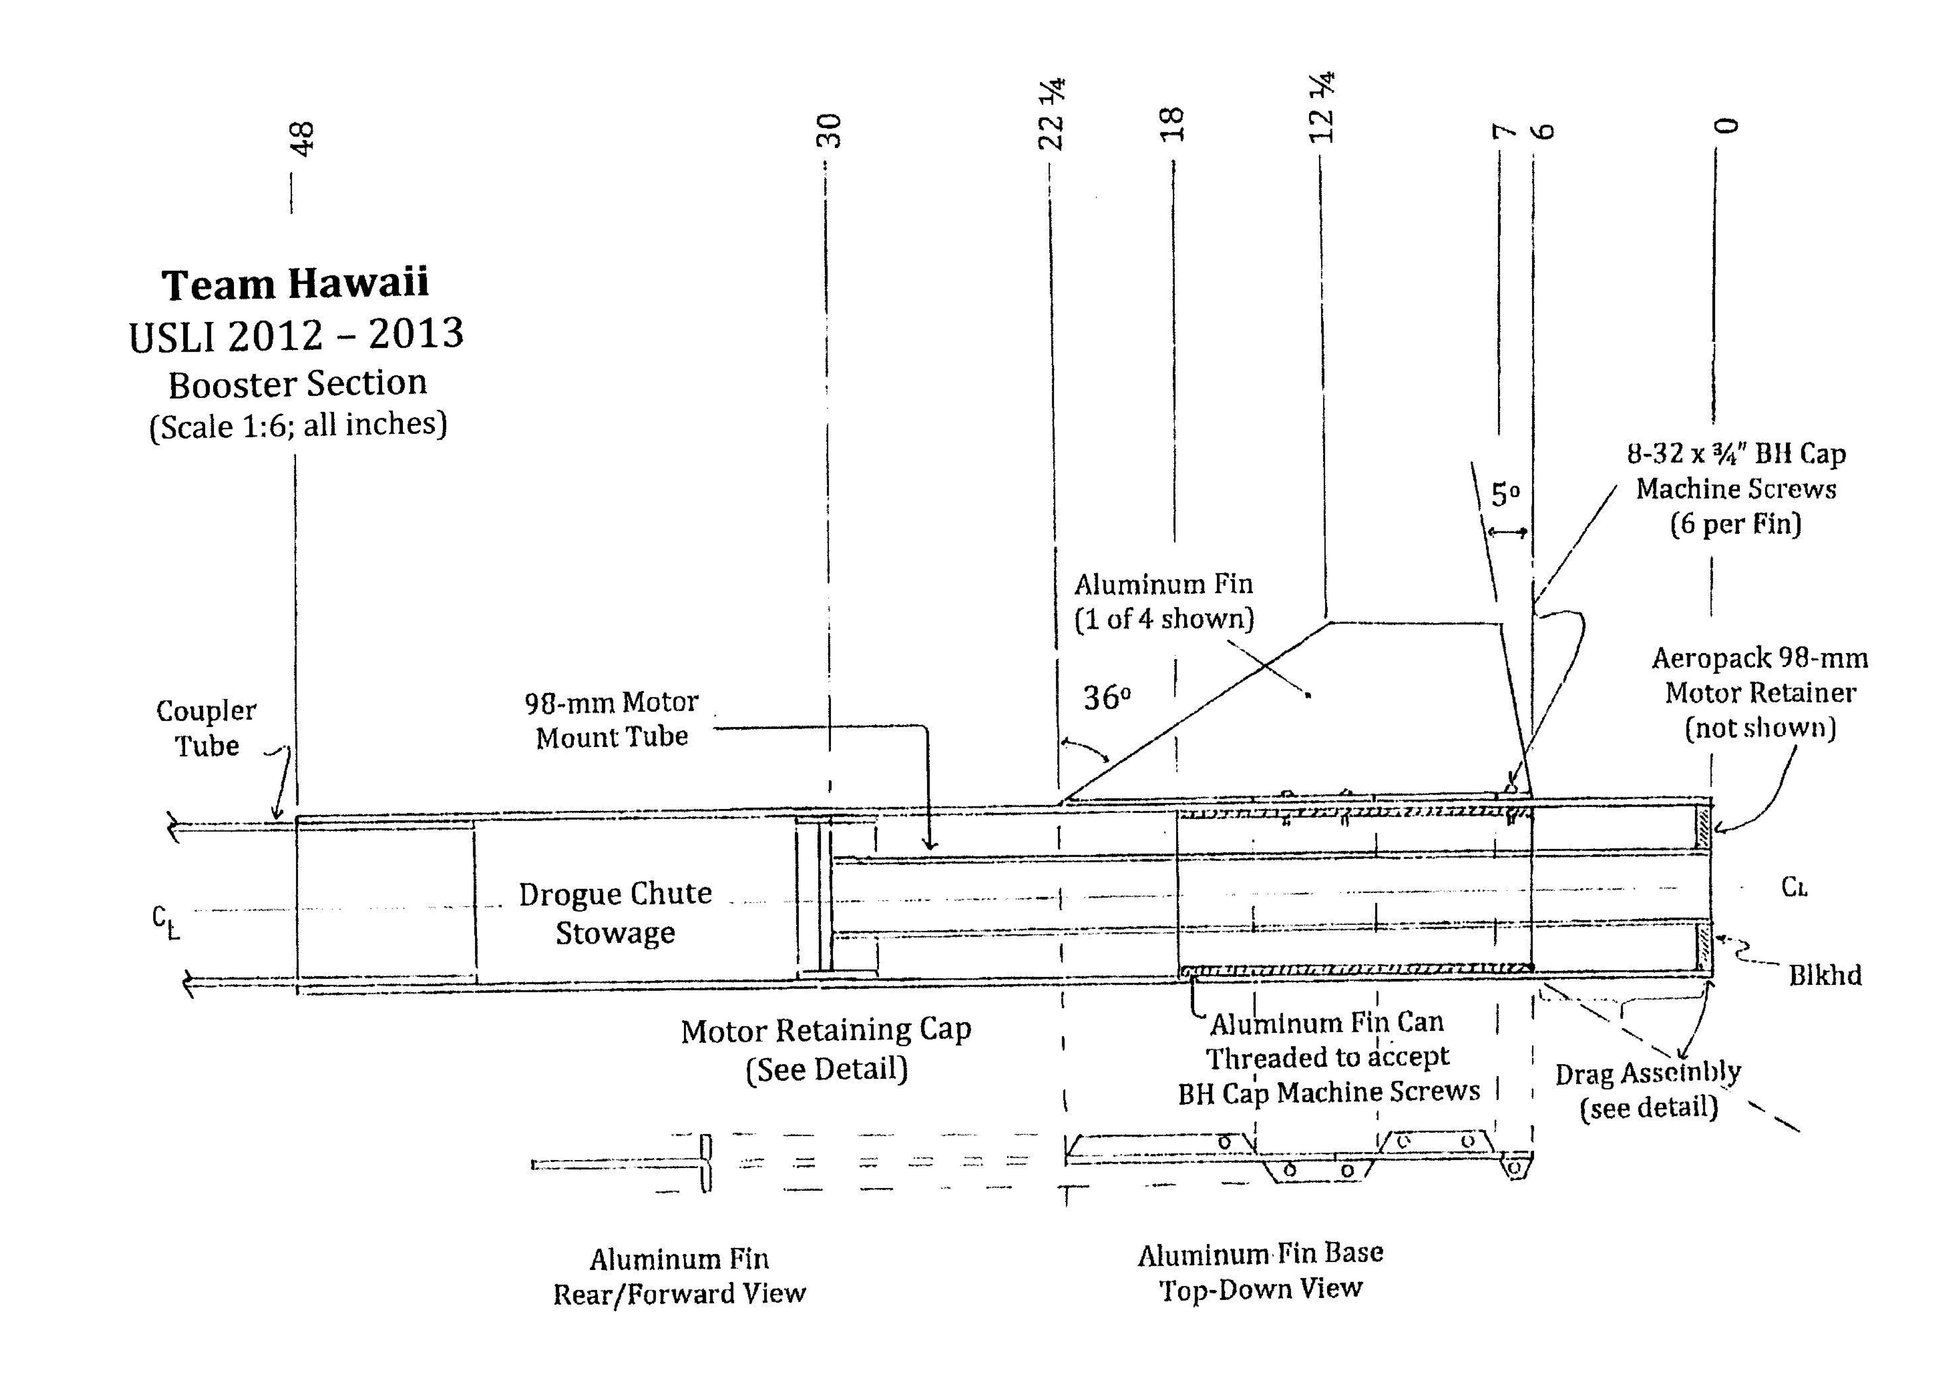

Slide 12
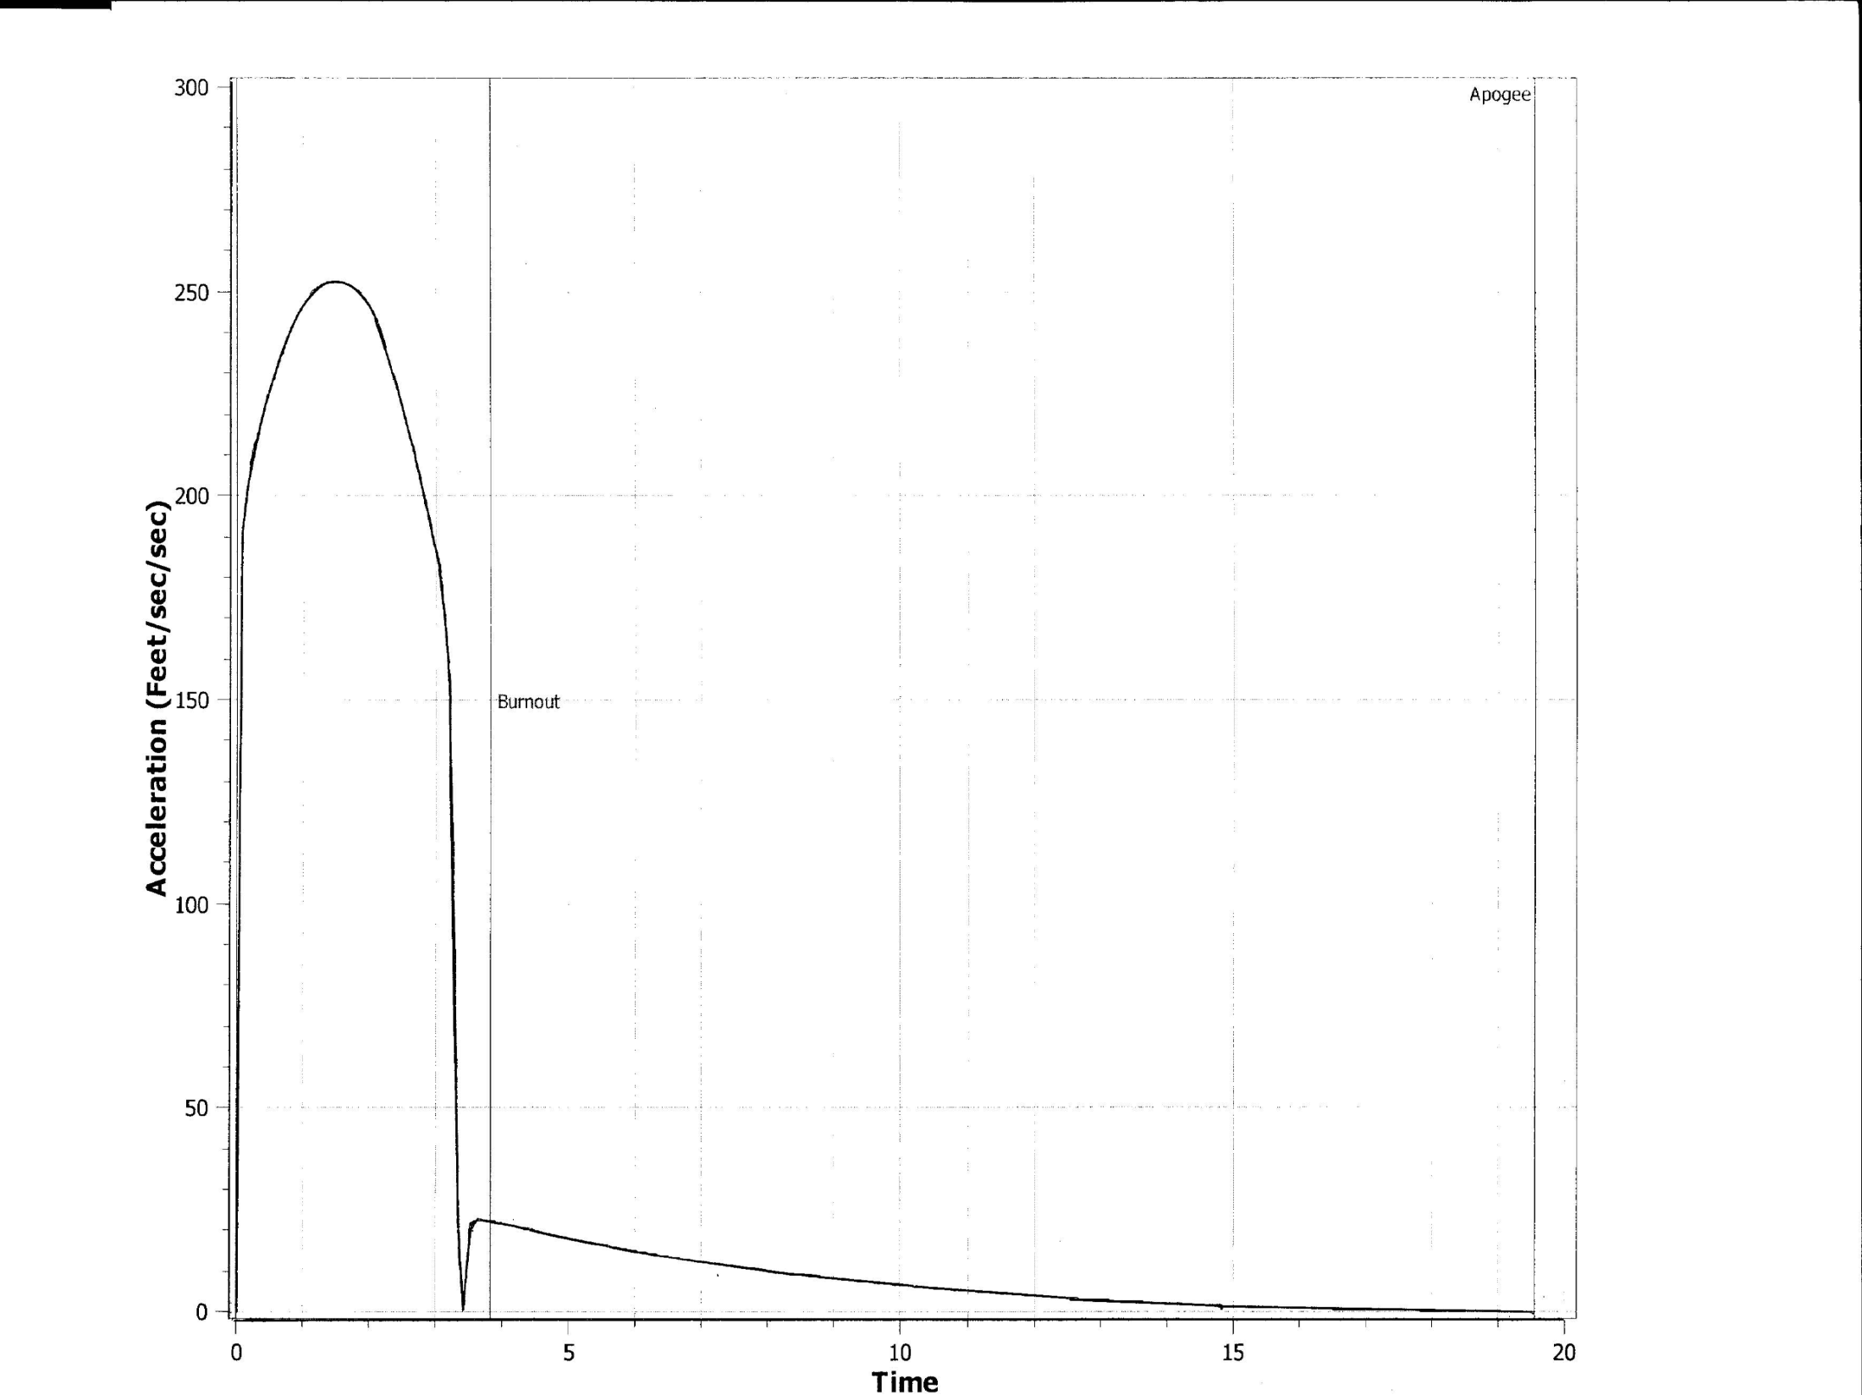

Slide 13
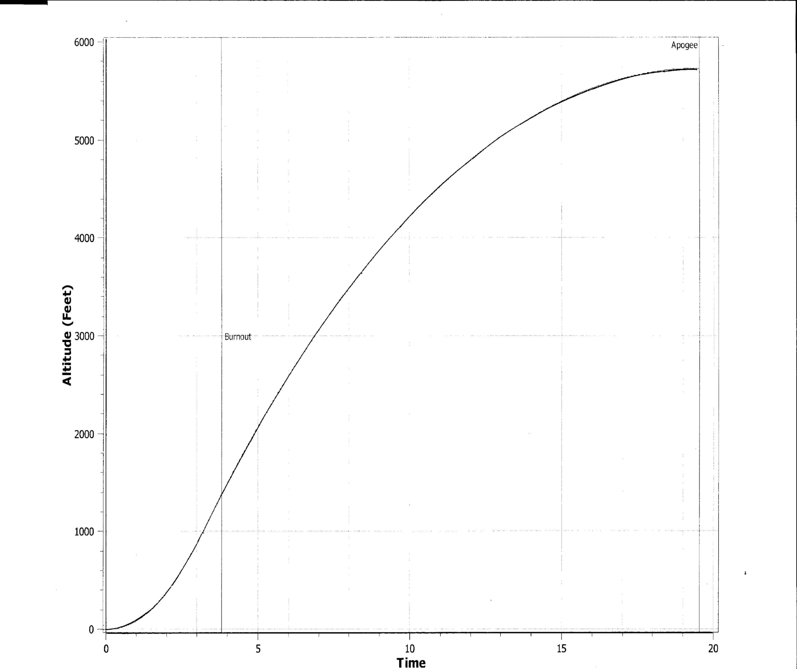

Slide 14
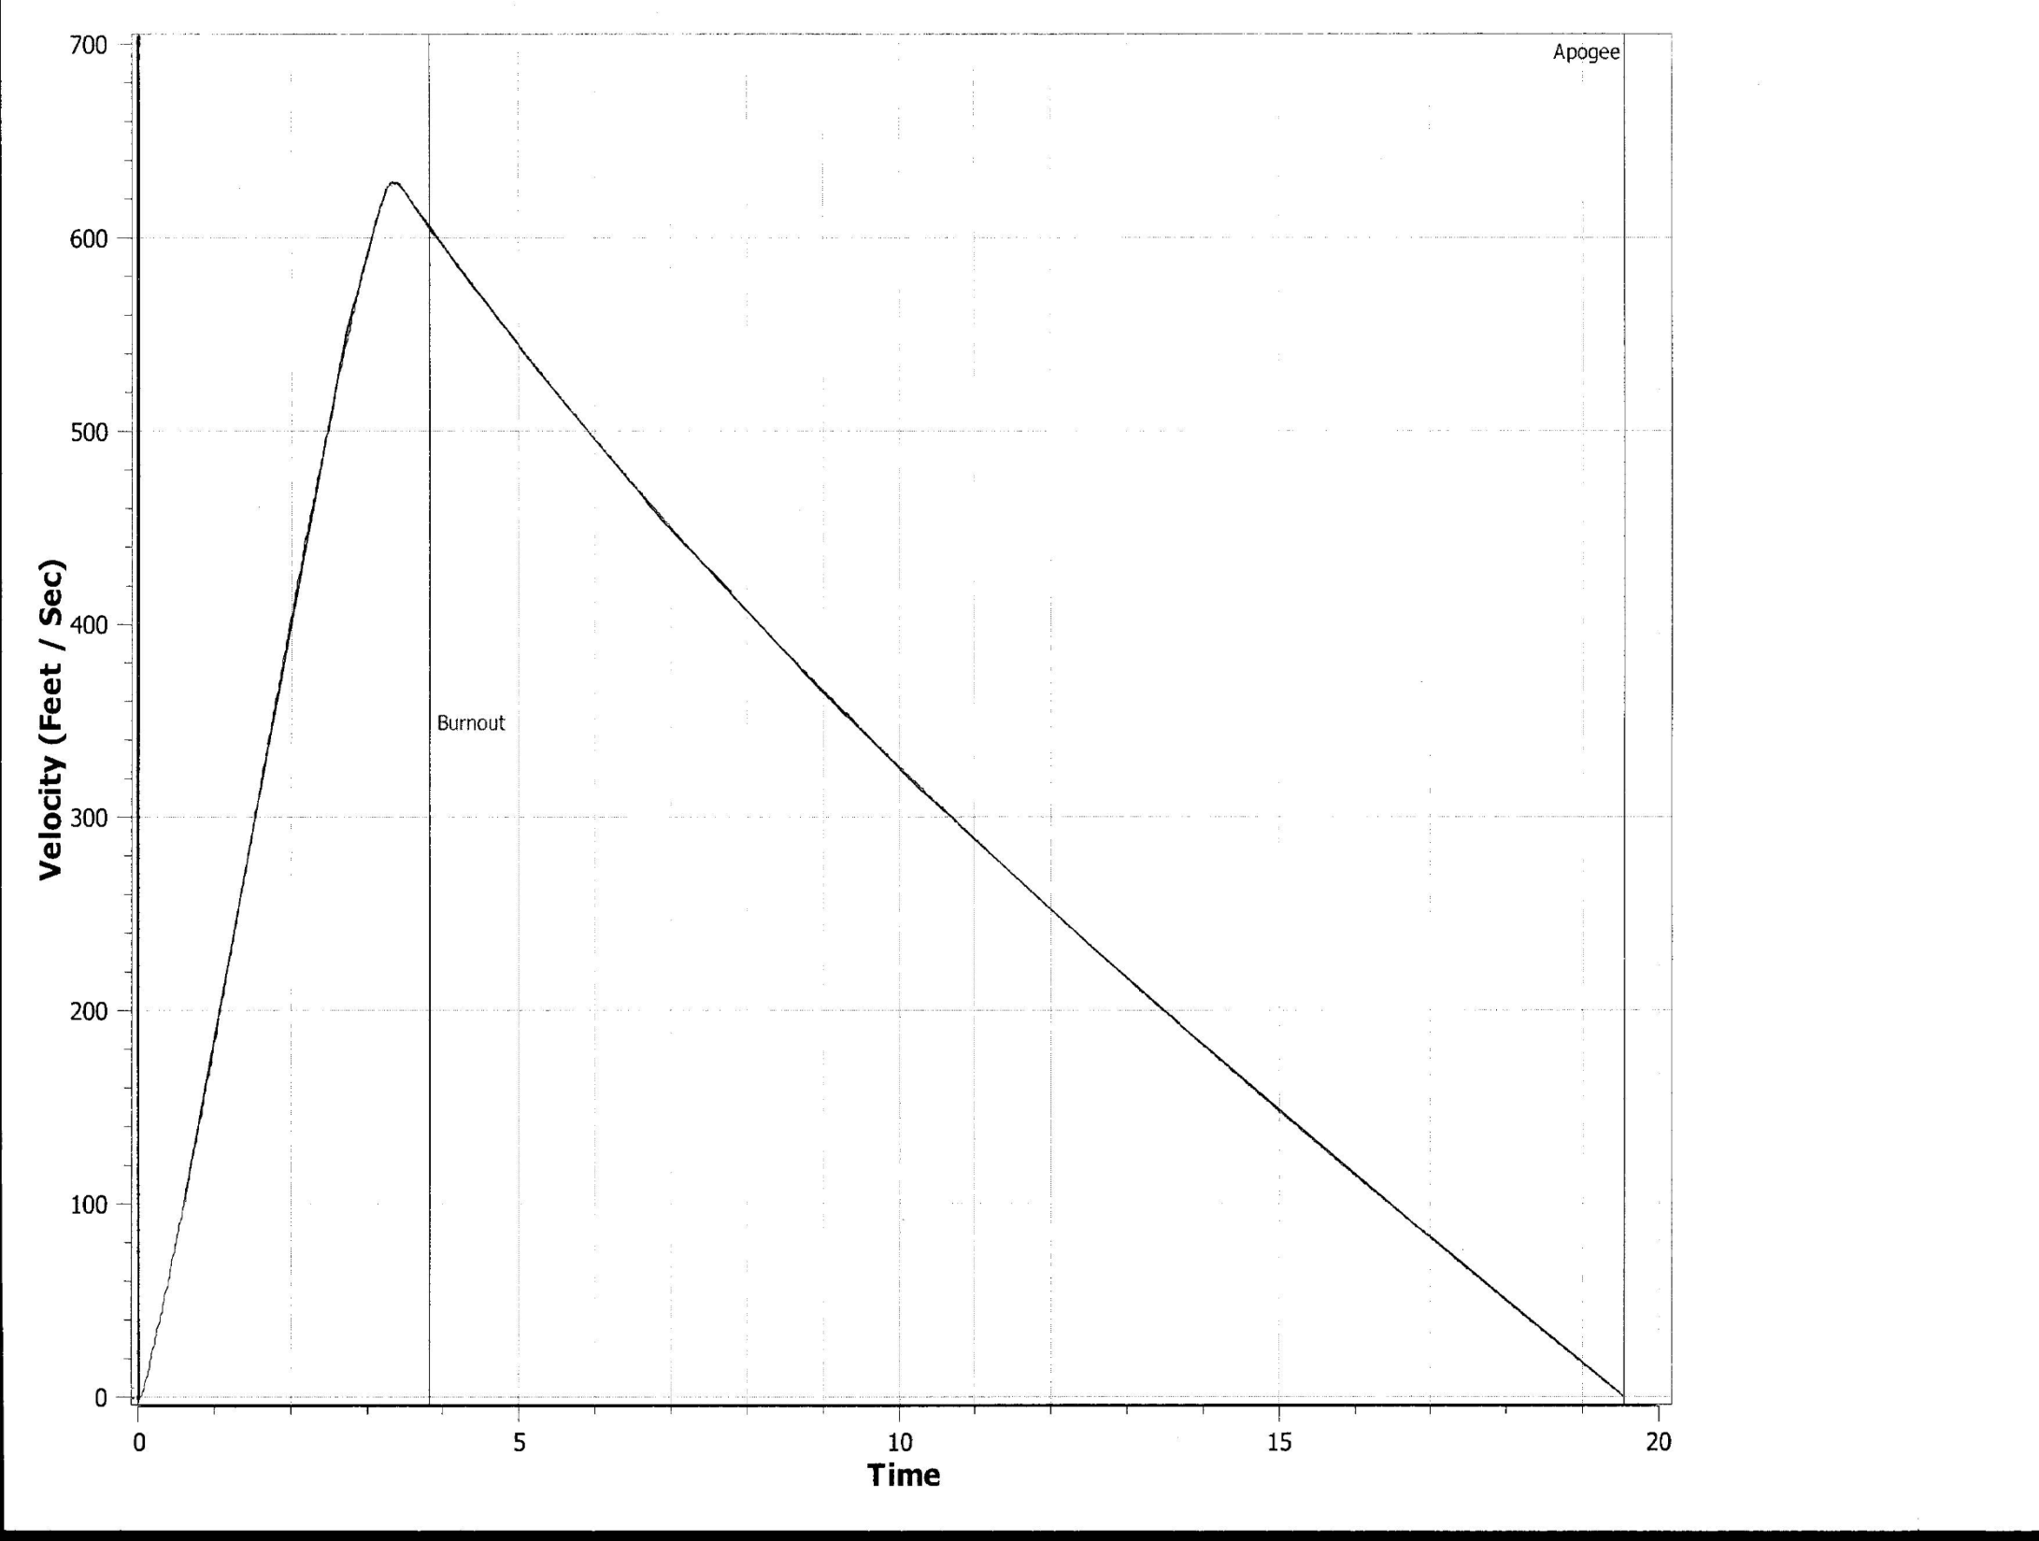

Slide 15
Motor Selection
AEROTECH L1500T
Total Impulse: 5120 Ns
Casing: 98/7680
Average Thrust: 1537 N
Peak Thrust: 2381 N
Burn Time: ~3.0 sec
Thrust to weight: ~7.4

Slide 16
Flight Characteristics
GPS Flight in nose cone
Variable Drag Configuration (VDC)
Four-fin design
Avionics
Dual-Deployment
16

Slide 17
Rocket Stability
Center of Pressure: 98.73 in.
Center of Gravity: 81.7 in.
Stability: 2.84
Rail Exit Velocity
-Rocket hits minimum safe speed (44 ft/s) at 68 in. during boost phase (before leaving rail).

Slide 18
Variable Drag Configuration
Drag force is linear to ~30 degrees
Approximate altitude loss ~1.2%/degree
30 degree deployment yields ~36% loss
Must yield max altitude below 7180 ft. and above 5280 ft.

Slide 20
Descent: Parachutes
Drogue Chute
42 in. diameter
Deployed at apogee
Descent at 70ft/s
Main Chute
144 in. diameter
Deployed at 2500 ft.
Descent at 21 ft/s
*Chutes will be connected by 2-ton, 20ft. shock cords

Slide 21
Descent: Kinetic Energy Calculations
Initial Descent Stage
KE = 3610 ft-lb
Final Descent Stage
Descending in three sections
KEA V= 61.6 ft-lb
KEBooster = 74.6 ft-lb
KENC/SMD = 53.5 ft-lb

Slide 22
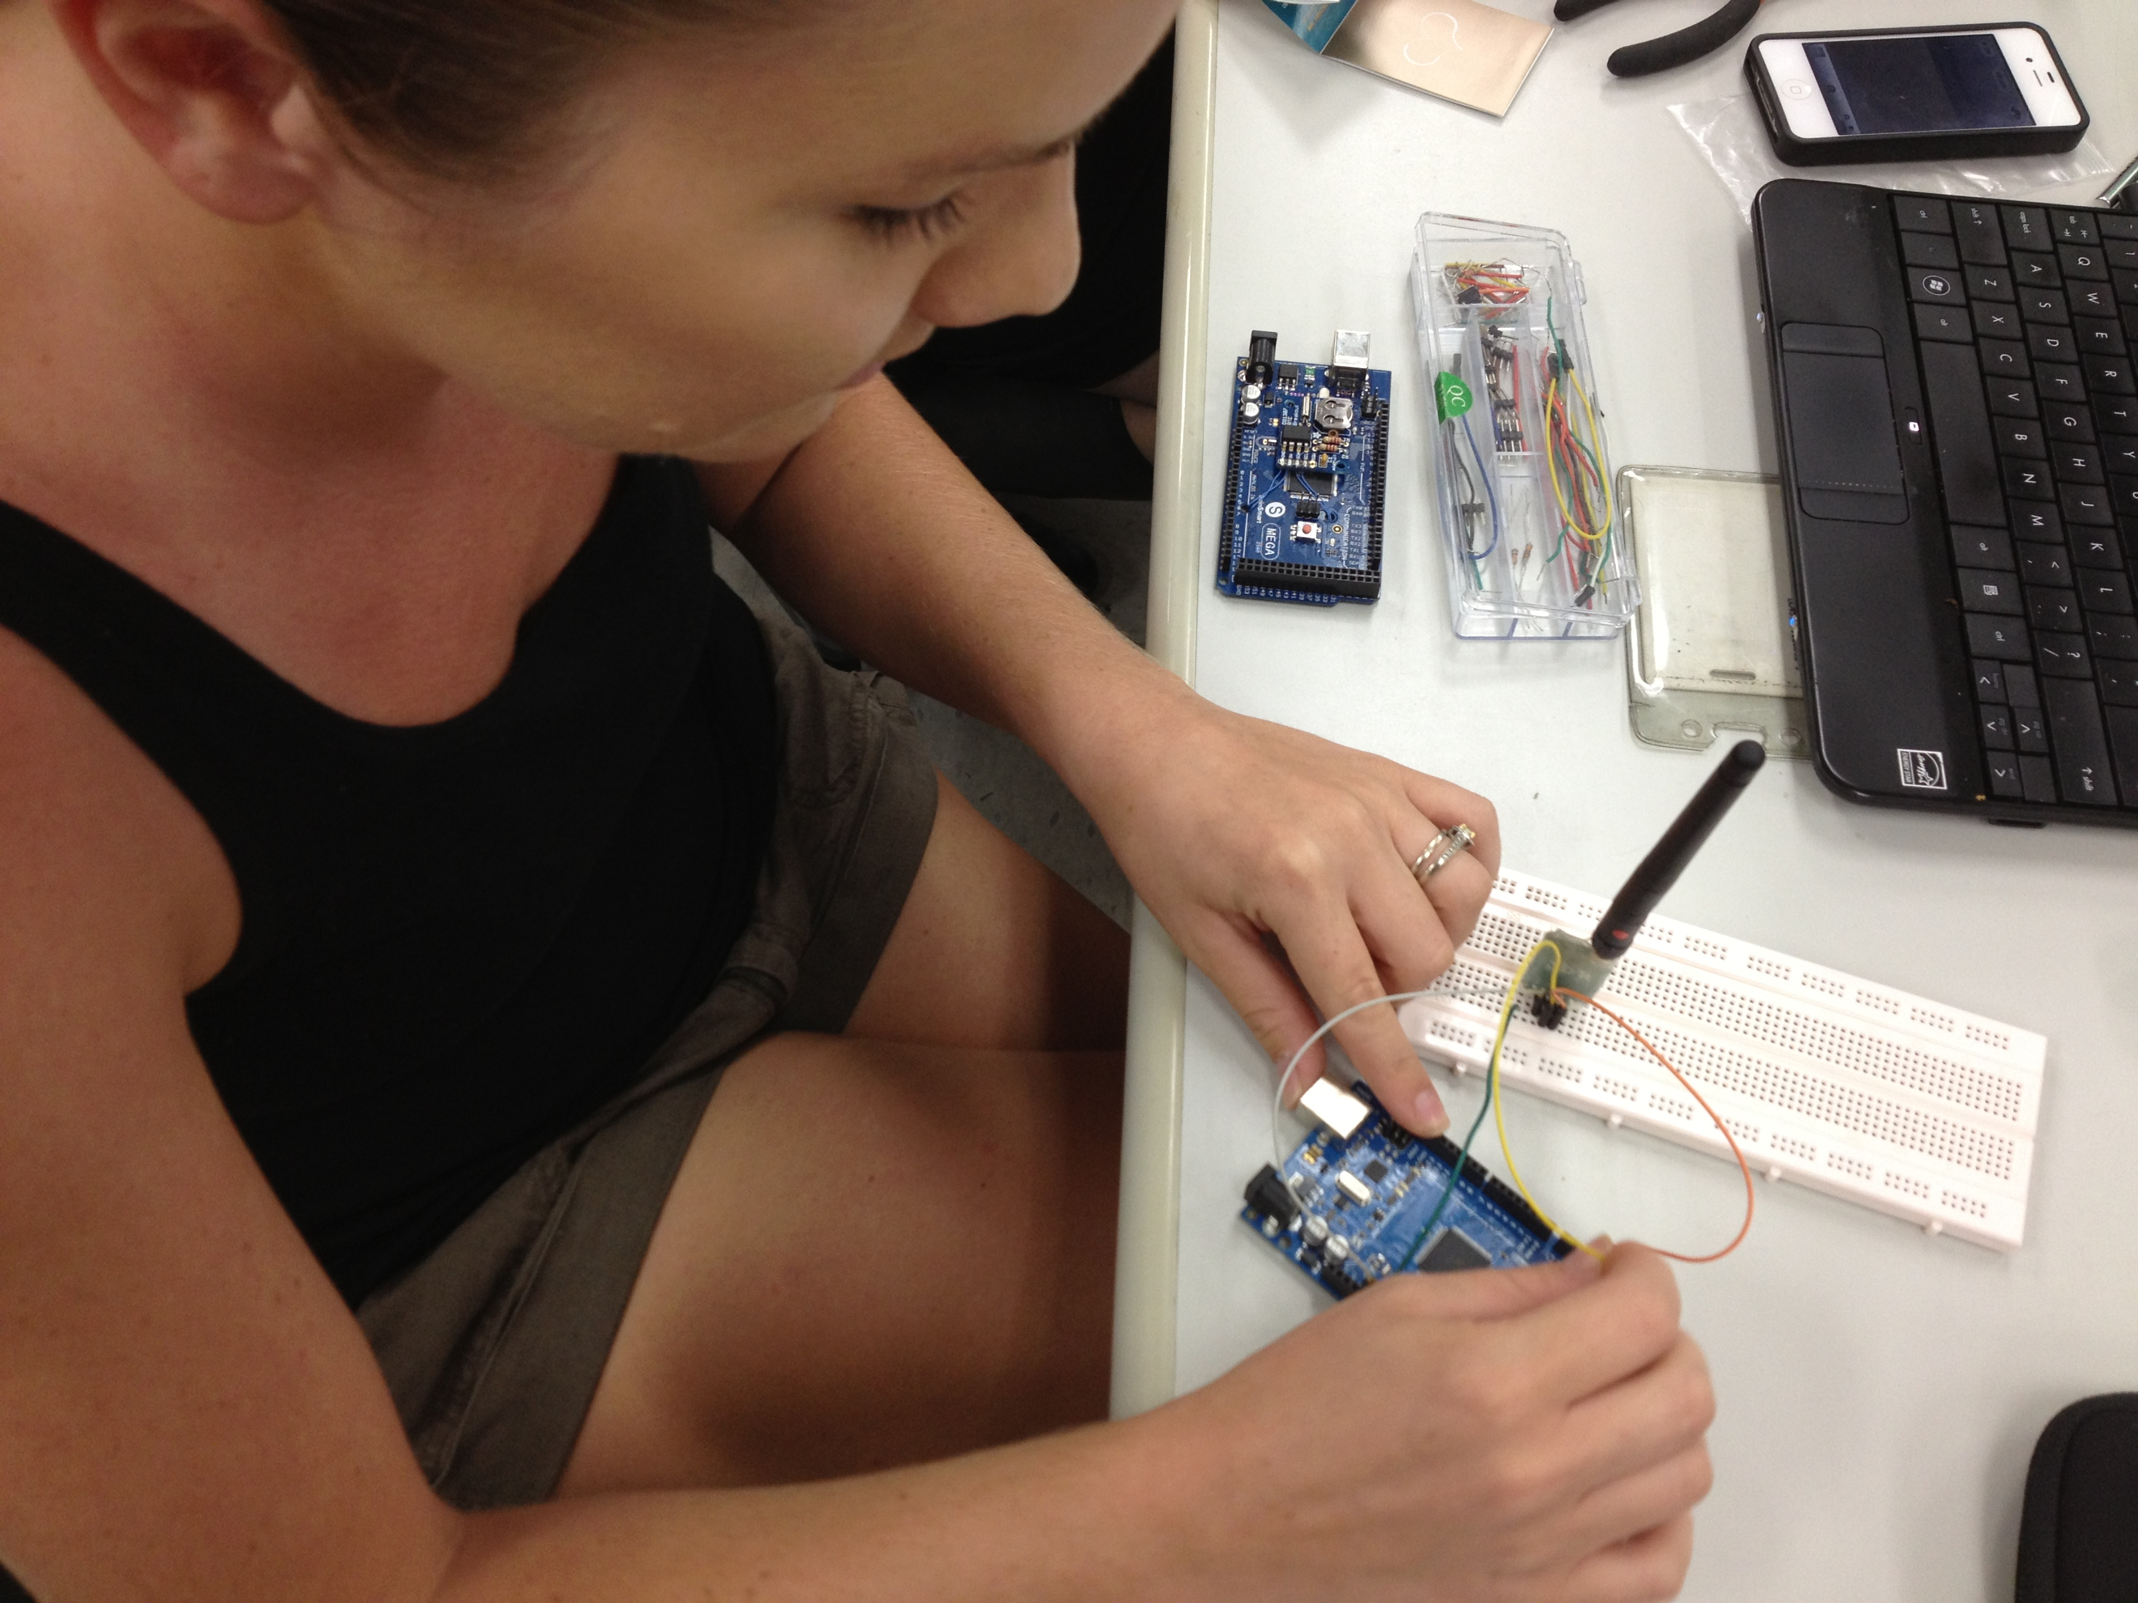
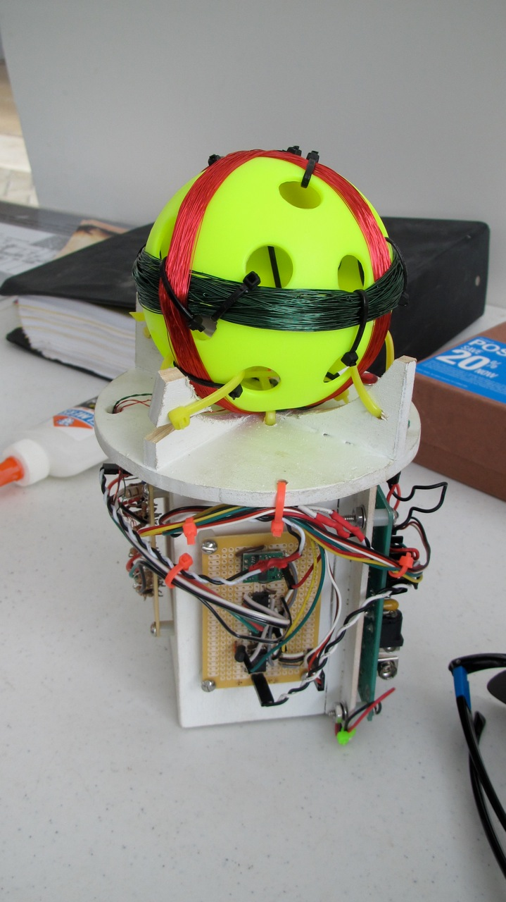
Wilfred
Arduino Nano
Magnetometer (3-axis)
Operational Amp
Micro-SD storage
Accelerometer (3-axis)

Slide 23
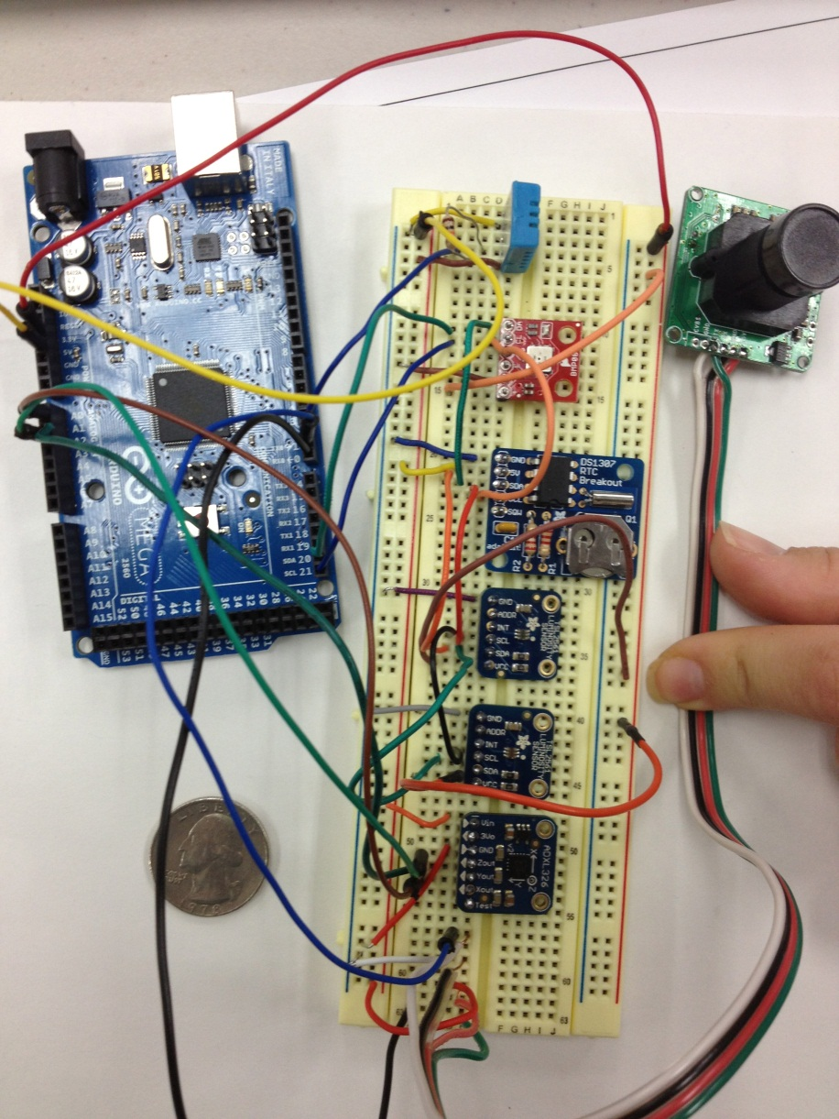
Wilfred
Arduino Mega 2560
Xbee-Pro
BMP085 – Temperature, Pressure,
Altitude
DHT11 – Humidity
TSL2561 – Light Sensor
TTL Serial JPEG – Camera
Real time clock

Slide 24
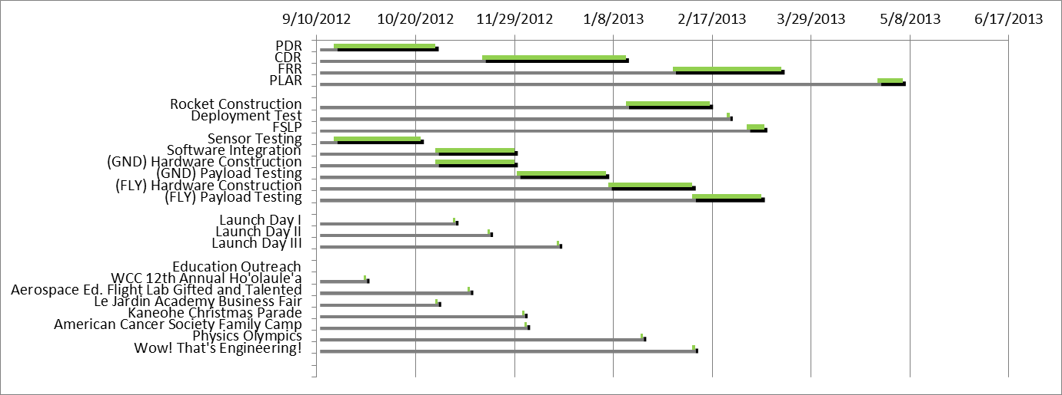
Timeline

Slide 25
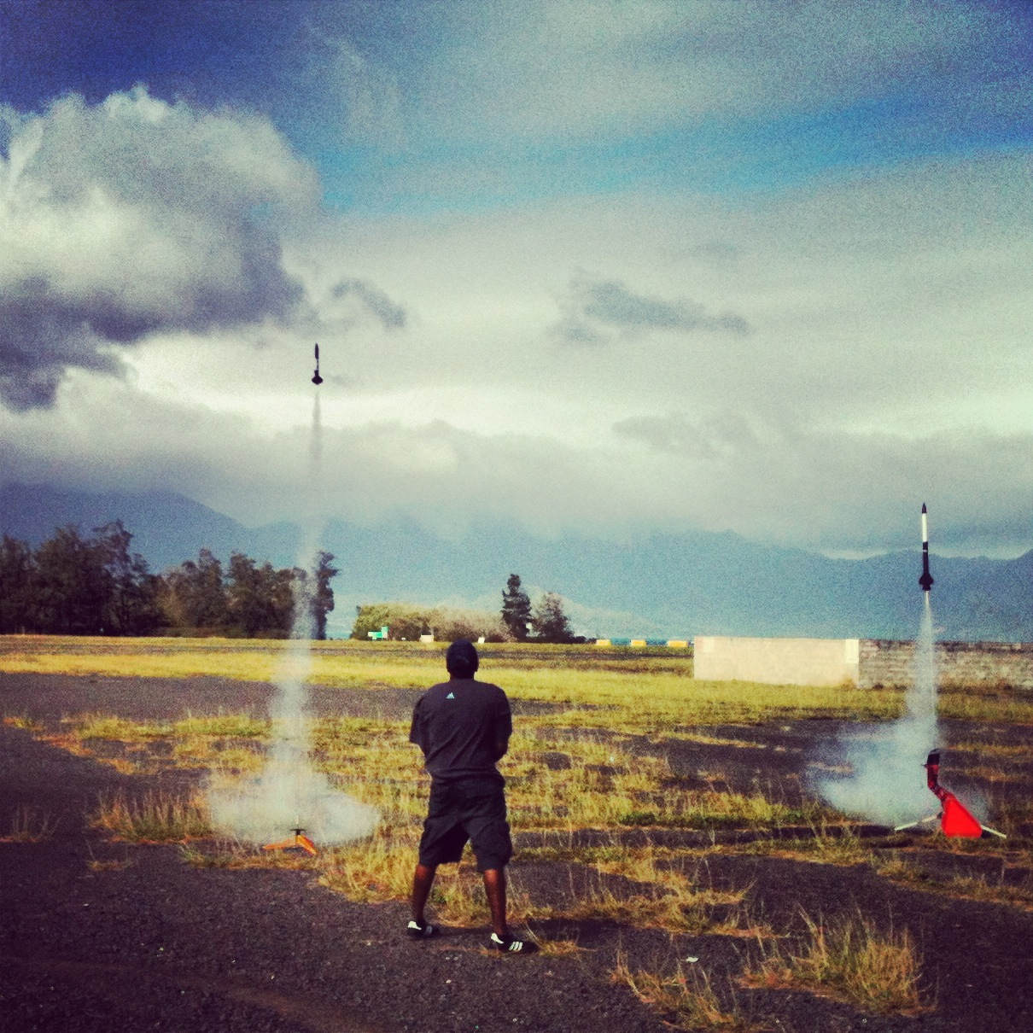
Important Dates
Rocket
Jan. 27 & Feb. 16- Subscale Testing
Feb. 23- Ejection Charge Test
Mar. 10- Full Scale Low Power

Slide 26
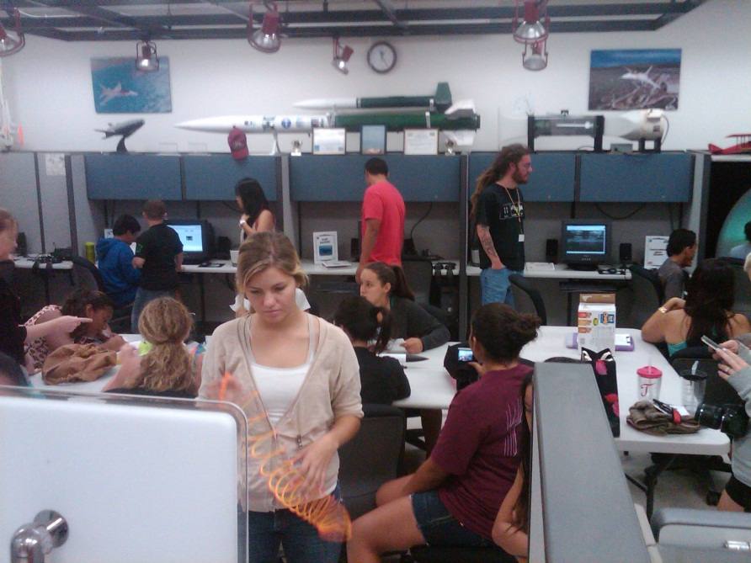
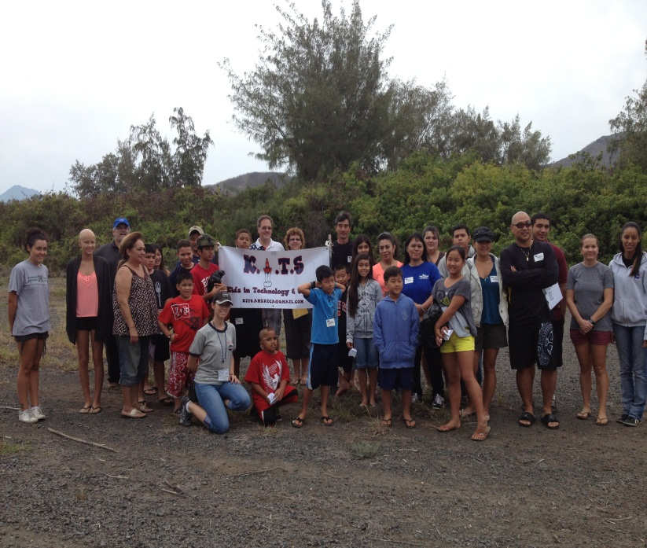
Important Dates
Education Outreach
Sept. 29- WCC 12th Annual Ho’olaule’a
Oct. 28- Le Jardin Academy Business Fair
Nov. 10- Aerospace Flight Lab Gifted & Talented
Dec. 2- Kaneohe Christmas Parade
Dec. 3- American Cancer Society Family Camp
Jan. 19- Physics Olympics
Feb. 9- Wow! That’s Engineering!

Slide 27
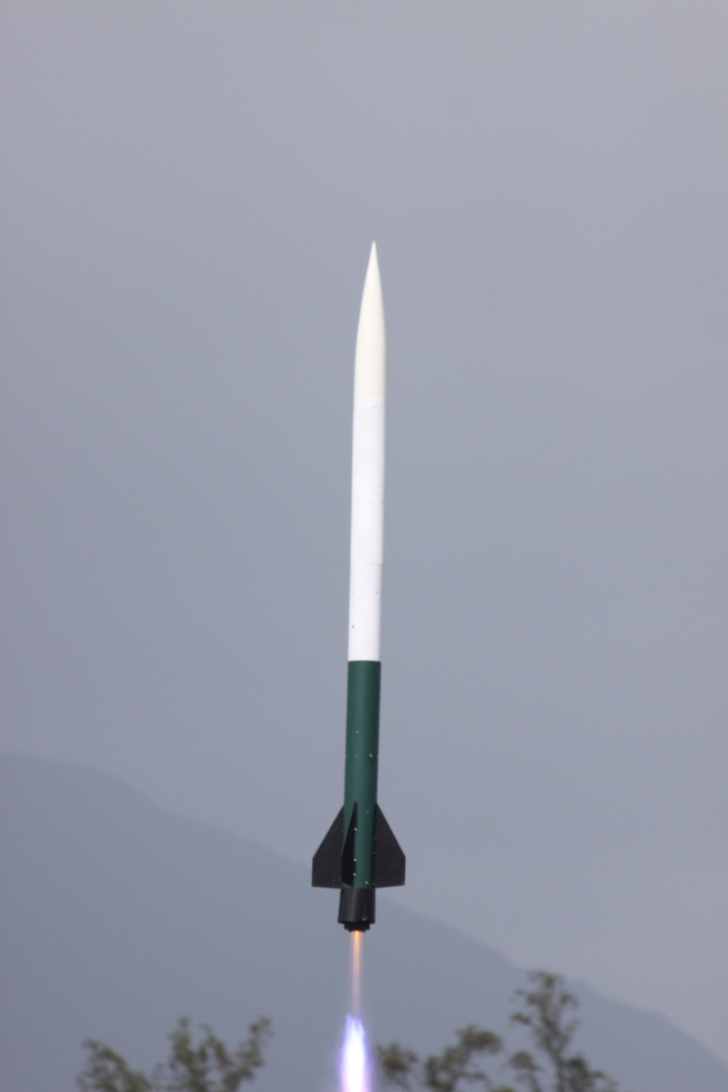
Acknowledgements:
Hawai’i Space Grant Consortium
Indigenous Knowledge in Engineering
Dr. Joe Ciotti
Dr. Jacob Hudson
Jim and Becky Green
Joleen Iwaniec

