Slide 1
Preliminary Design Review
Windward Community College
University of Hawaii
2012-2013

Slide 2
Rocket: The Green Machine Payloads: Wilfred
Team Official: Dr. Jacob Hudson
Ke Kime Kao Lele Keu Loa
Kristi Ross
Lyra Hancock
Warren Mamizuka
Ada Garcia
Kristin Barsoumian

Slide 3
Rocket Design Criteria
Build a Rocket to be launched to an altitude of 5280 ft. (1 mile)
Rocket must carry a scientific payload
Rocket must return safely

Slide 4
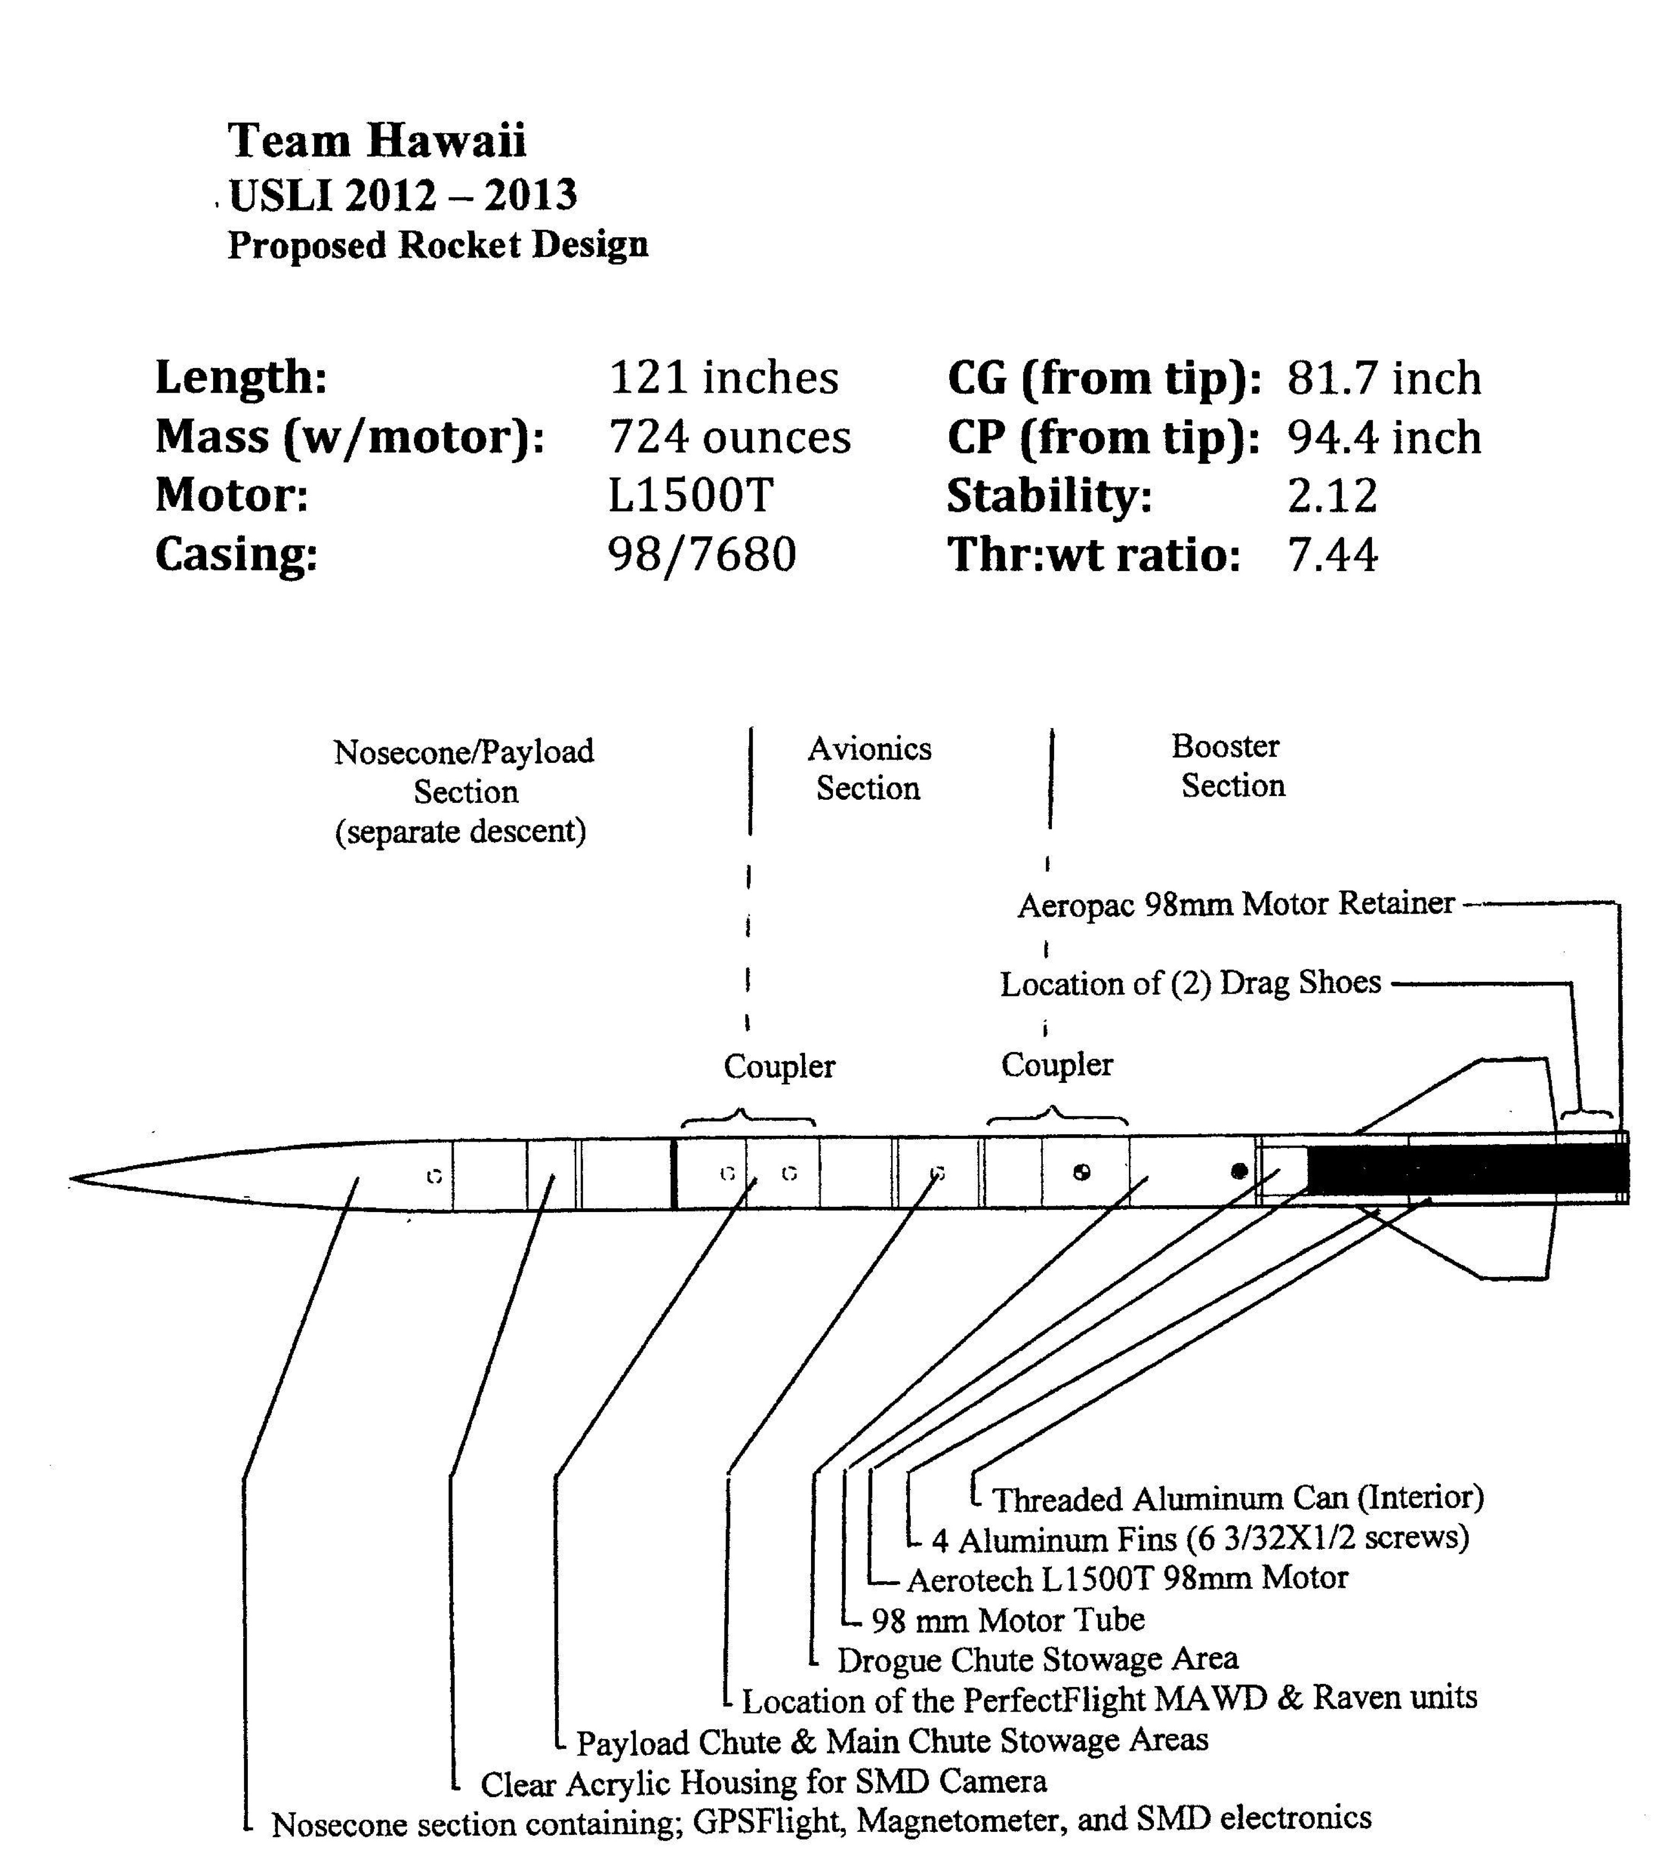
The Green Machine

Slide 5
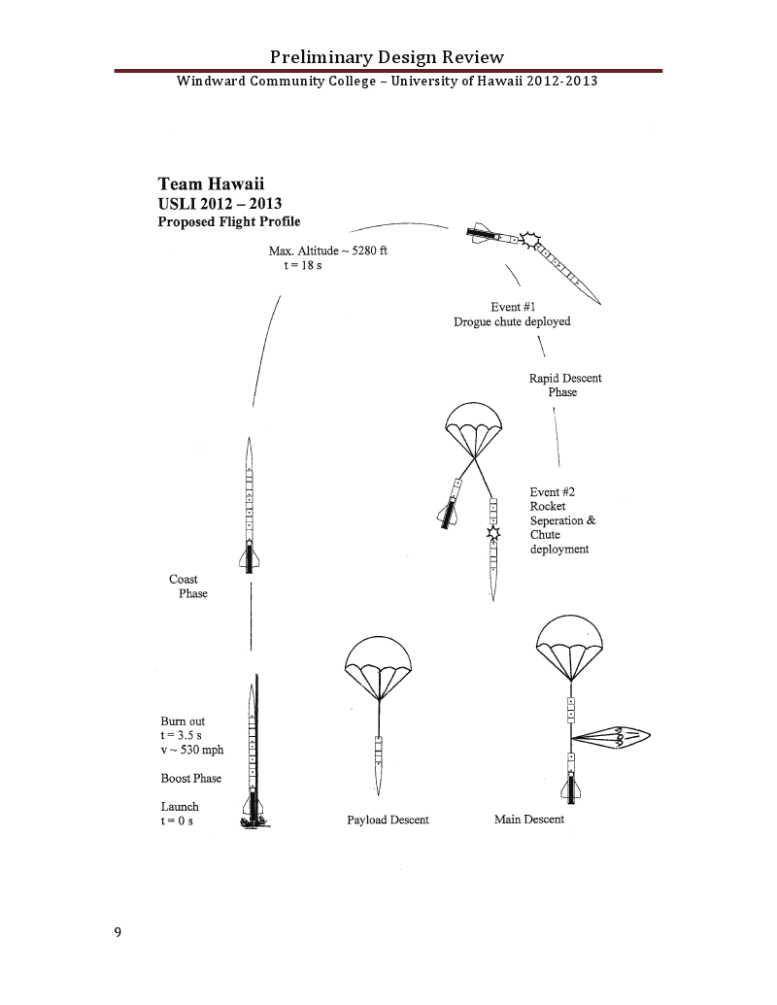
Flight Profile

Slide 6
Rocket Design Details
Length: 121”
Diameter: 6”
Unloaded Weight: 496 oz.
Weight: 724 oz.
Materials: G10 Fiberglass
Recovery: Dual Deployment, electronic
Propulsion: AEROTECH L1500T

Slide 8
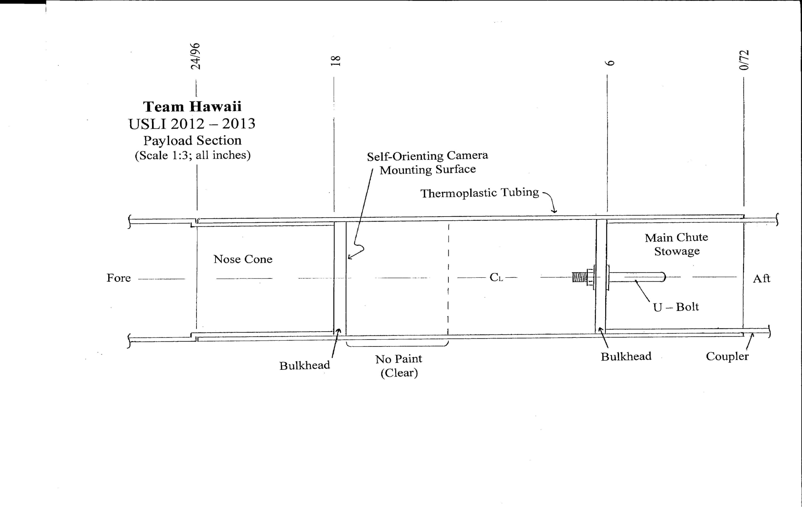

Slide 12
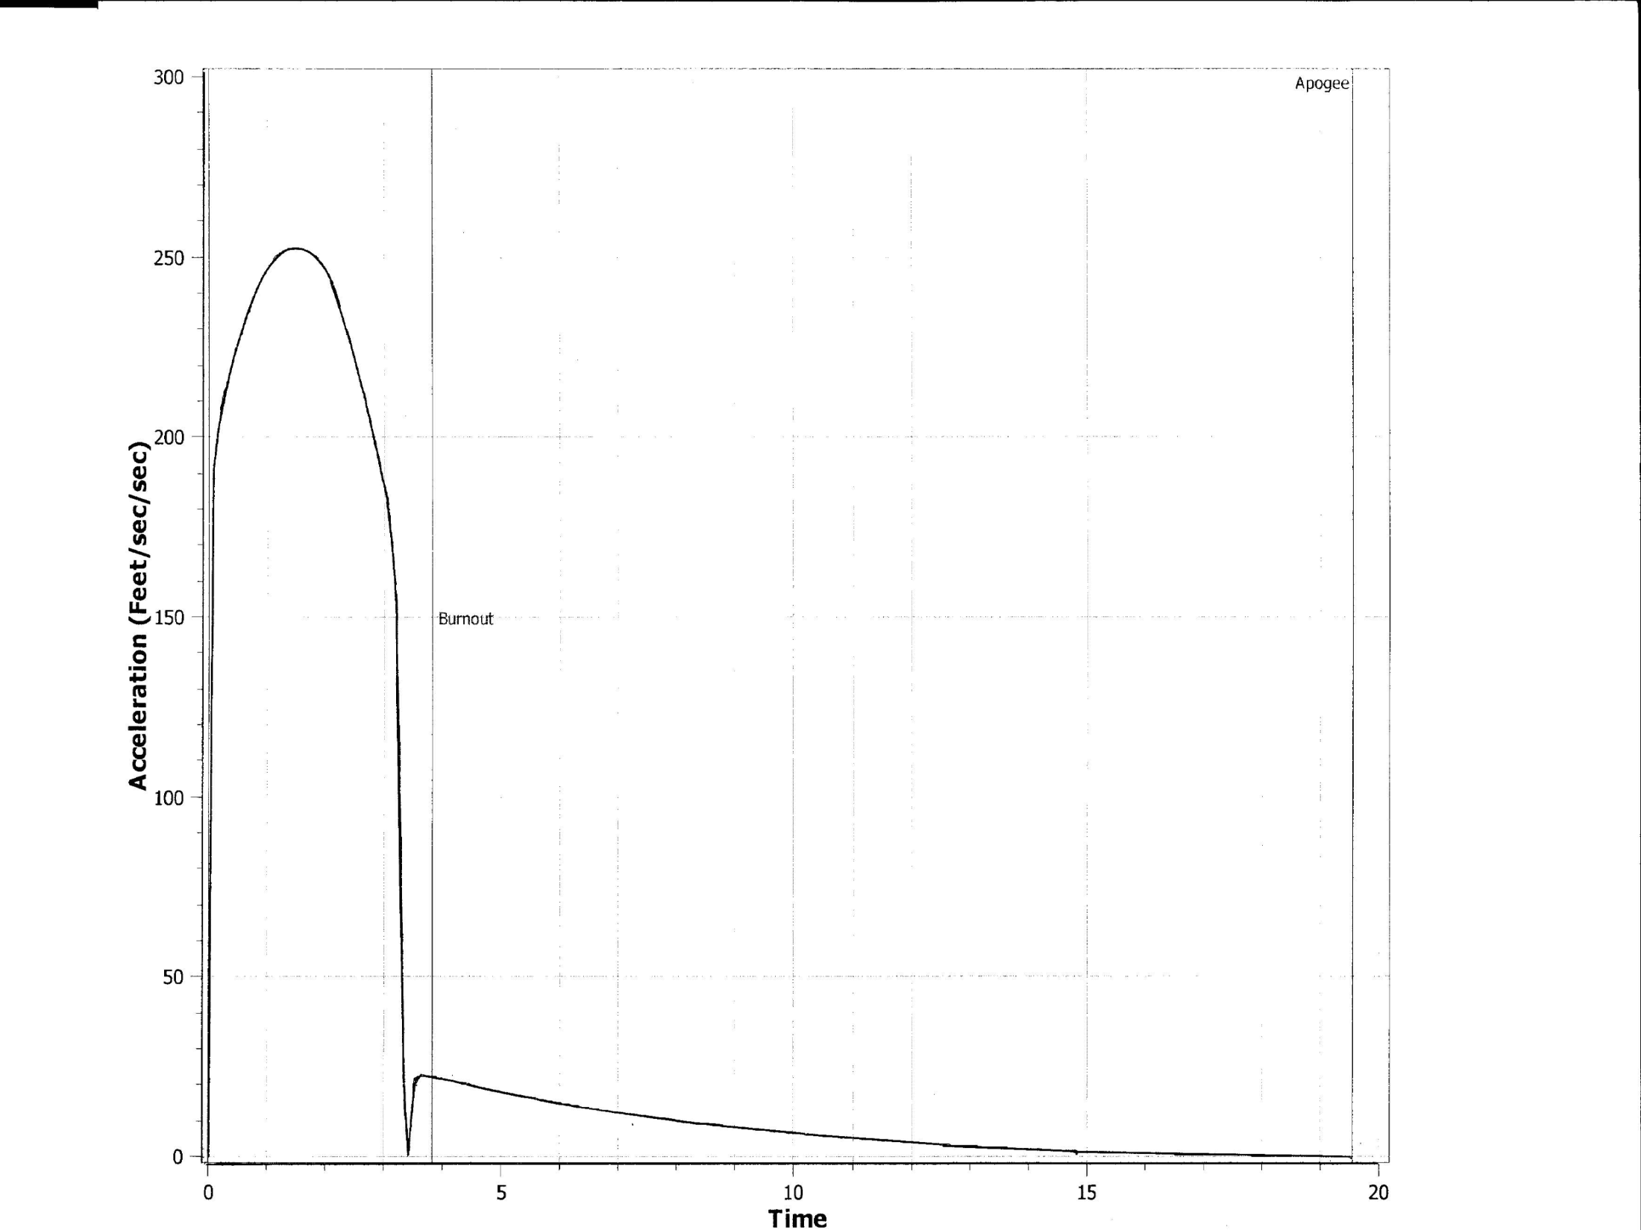

Slide 13
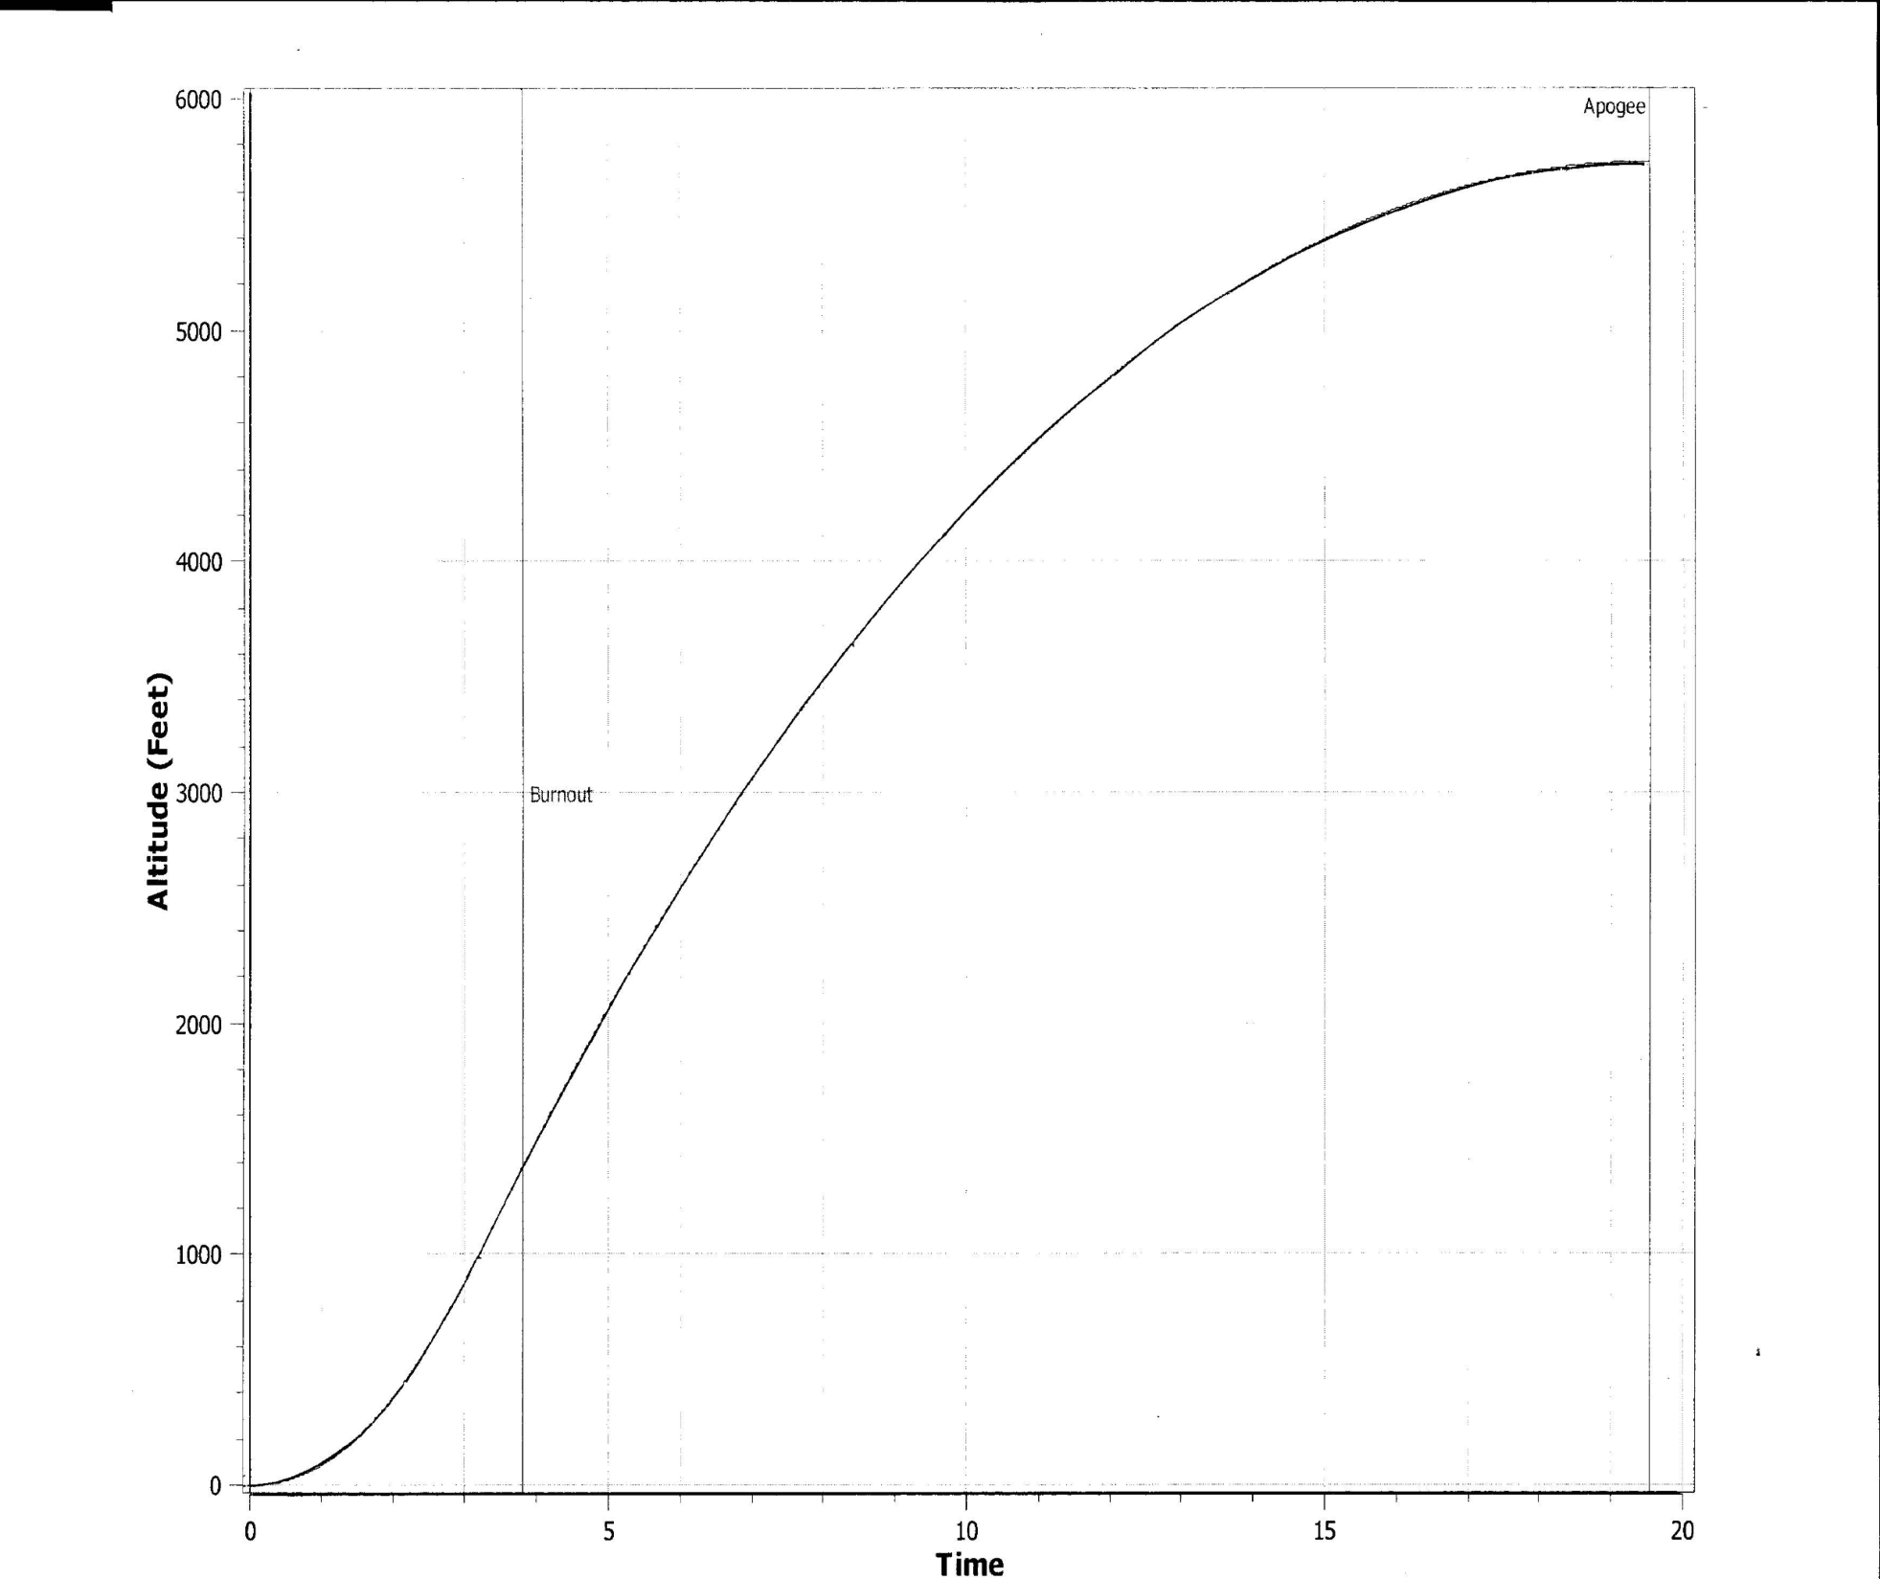

Slide 14
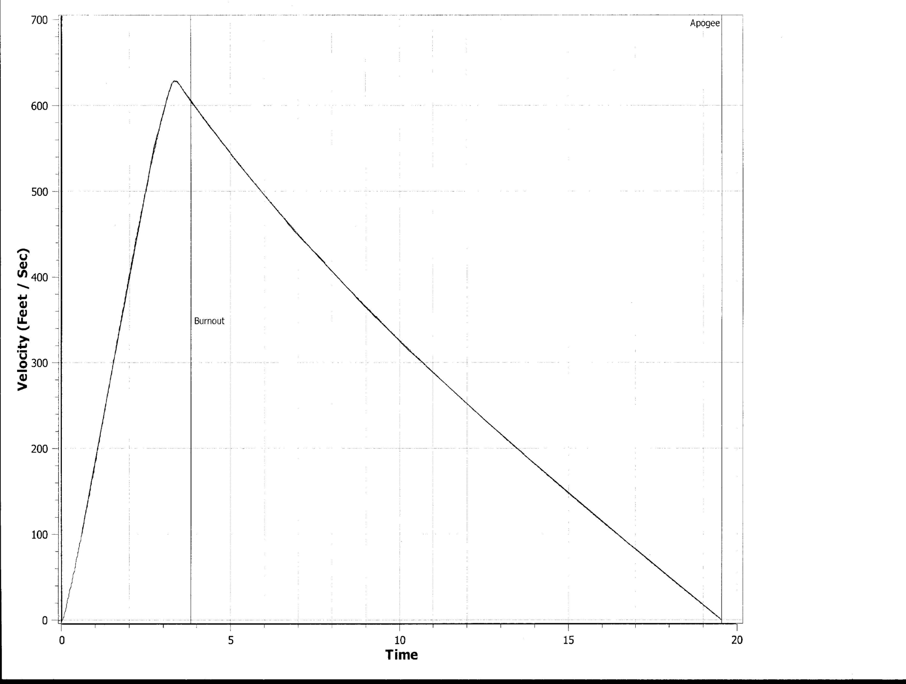

Slide 15
Characteristics
GPS Flight in nose cone
Variable Drag Configuration (VDC)
Four-fin design
Avionics
Dual deployment

Slide 16
Rocket Stability
Center of Pressure: 94.4”
Center of Gravity: 81.7”
Stability: 2.12

Slide 17
Motor Selection
AEROTECH L1500T
Total Impulse: 5120 Ns
Casing: 98/7680
Average Thrust: 1537 N
Peak Thrust: 2381 N
Burn Time: ~3.0 sec
Thrust to weight: ~7.44

Slide 18
Variable Drag Configuration
Drag force is linear to ~30 degrees
Approximate altitude loss ~1.2%/degree
30 degree deployment yields ~36% loss
Must yield max altitude below 7180 ft and above 5280 ft

Slide 19
Wilfred
Magnetometer (3-axis)
12-bit ADC
Operation Amp
Micro SD storage
Accelerometer (3-axis)

Slide 20
Wilfred
Arduino Nano
Xbee-Pro
BMP085 – Temperature, Pressure, Altitude
DHT11 – Humidity
TSL2561 – Light Sensor
TTL Serial JPEG – Camera
Real time clock

Slide 21
Timeline

Slide 22
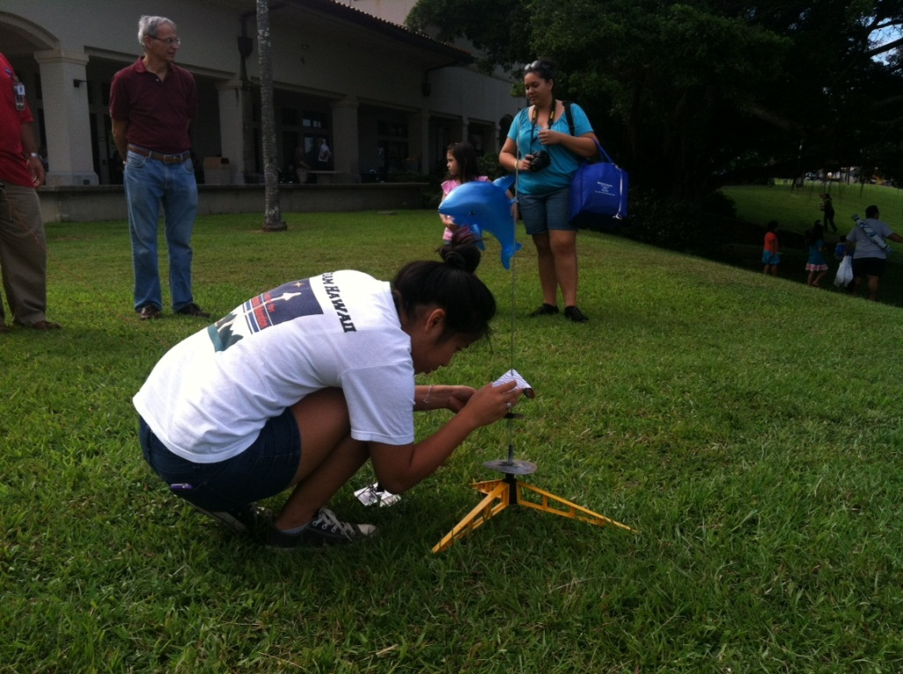
Important Dates
Rocket
November 4 – Subscale testing
January 3 – Subscale testing
January 19 – Ejection Charge Test
March 10 - Full Scale Low Power
Education Outreach
October 28
December 1
December 2

Slide 23
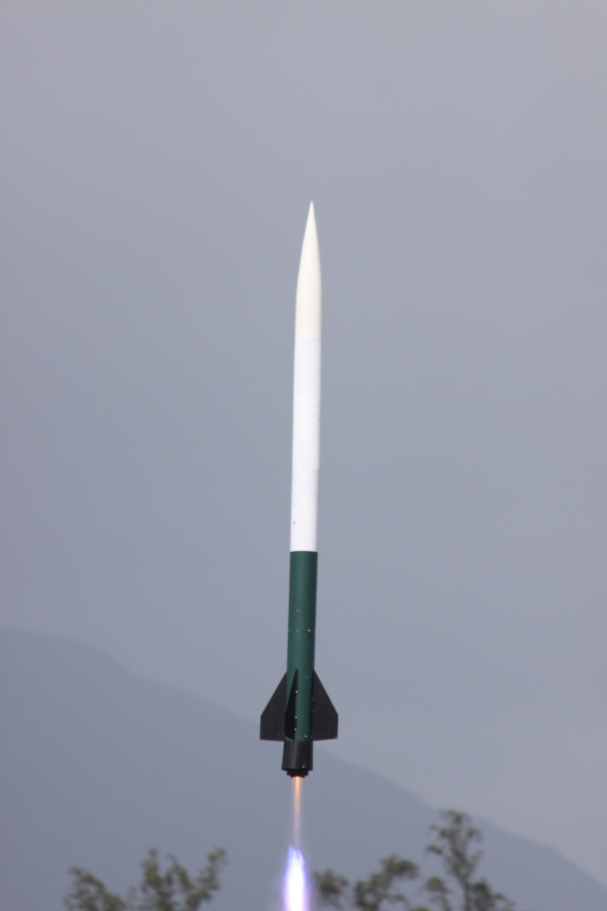
Acknowledgements:
Hawai’i NASA Space Grant Consortium
Indigenous Knowledge in Engineering
Dr. Joe Ciatti
Dr. Jacob Hudson
Jim and Becky Green

