Slide 1
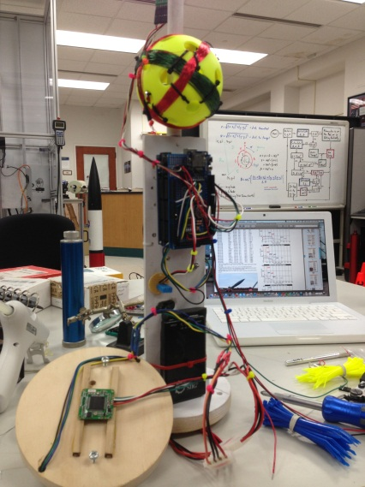
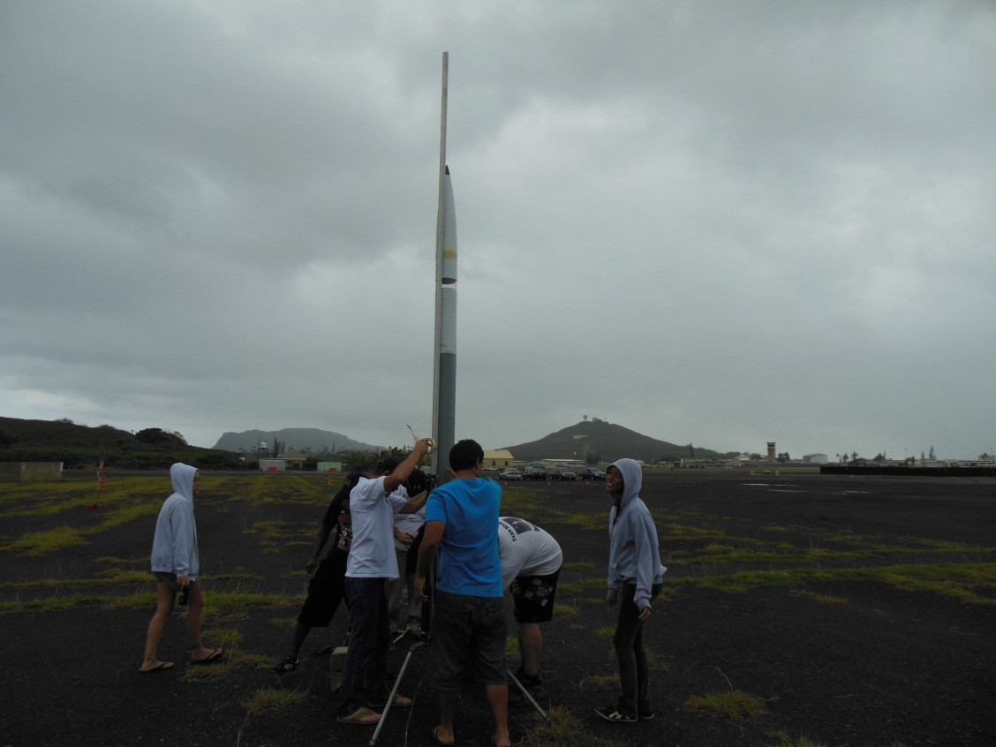
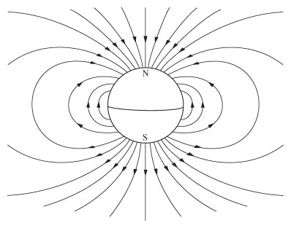
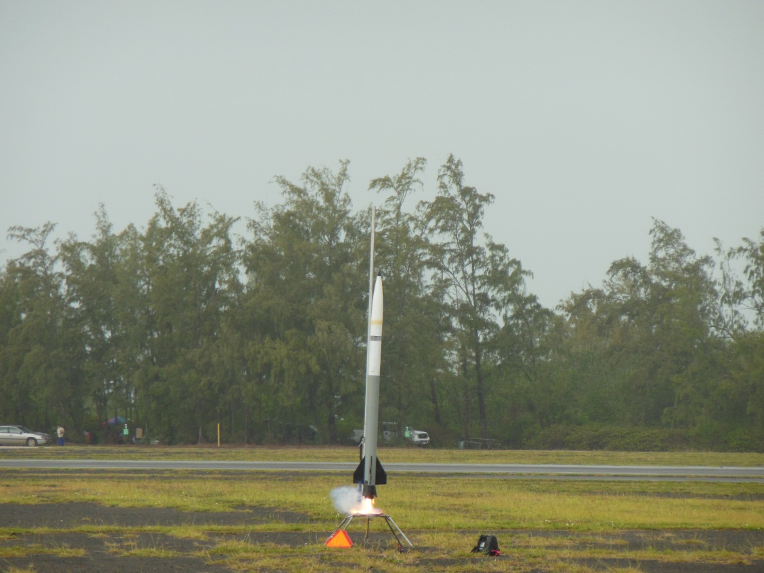
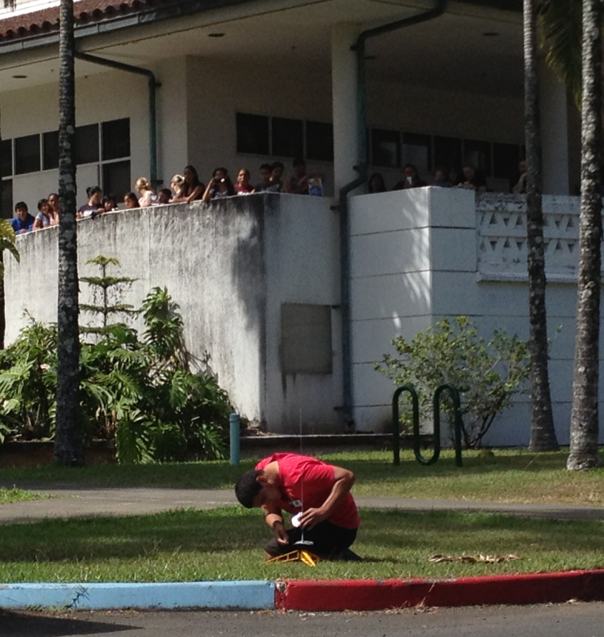
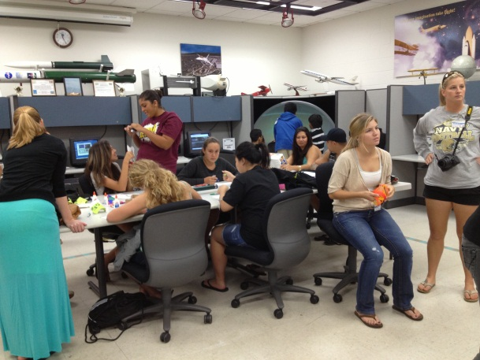
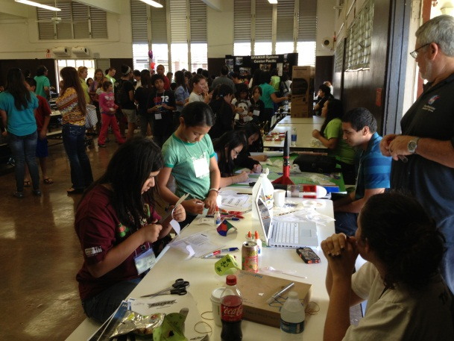
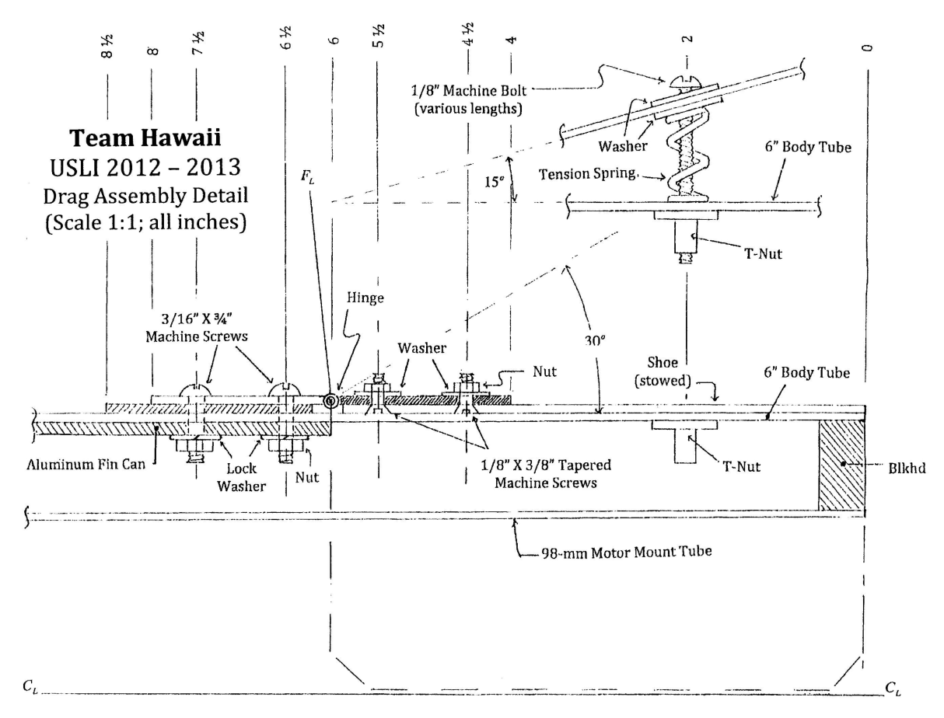
Hawaii Space Grant Consortium
Wilfred
SMD & Magnetometer
How we got here
Chartered under the National Space Grant College and Fellowship Program, the Hawai‘i Space Grant Consortium develops and runs interdisciplinary education, research, and public service programs related to space science, earth science, remote sensing, human exploration and development of space, small satellites, and aerospace technology. We accomplish this through a variety of projects: Undergraduate research fellowships and traineeships, innovative college courses, workshops for educators, educational web sites, public exhibitions, lectures, tours, primary school programs, space-themed summer camps for families, and more.
University Student
Launch Initiative
2012-2013
The Science Mission Directorate is a payload that must satisfy several criteria specified by NASA. The payload must gather data about several atmospheric variables, descent photos, ground photos, and transmit the data to a ground station ten minutes after landing.
The magnetometers’ purpose is to passively determine the orientation throughout the flight. As the rocket goes through its flight the payload will travel through the Earth’s magnetic field. In doing so, an induced voltage will be produced, due to the interaction of three perpendicular coils with the Earth’s magnetic field.
Launch Vehicle Summary
Rocket Name: The Green Machine
124 inches in length
6” diameter
L1500T 98-mm motor
42” drogue deployed at apogee
144” main to be deployed at 2500’ altitude
60” payload chute to be deployed at 2500’ altitude
Outreach
WCC’s Aerospace Education Lab (AEL)
&
Center for Aerospace Education (CAE)
Magnetometer Theory
http://4.bp.blogspot.com/_6scJOB1js-w/R2U-sshGc1I/AAAAAAAAAKg/RkV5_issi-k/s400/Dipole_field.jpg
Is it possible to determine the rocket orientation, at any given instant in its flight path, by studying the induced voltage produced by the interaction of the Earth’s magnetic field and three mutually perpendicular coils? The Faraday law of Electromagnetic Induction predicts that this should be so, and our experiment is to test this. If this is successful, there are several applications possible. By integrating this unit into a proper feedback network, a rocket stability system could be implemented.
Variable Drag Configuration (VDC)
A simple approach to estimating the enhancement of drag force, acting on the rocket by the deployment of the drag-shoes can be found. Take the geometry of a deployed drag-shoe to be that of a half cylinder (of radius r, just slightly larger then that of the rocket, and having a length l) canted at an angle of q to that of the rocket body. The canted drag shoe is hinged at the leading edge, and held open, to a specified degree, at the trailing edge by a spring-screw assembly. By comparing the drag force utilizing the deployed drag shoes…
Windward’s AEL and CAE is the team’s primary work area and also provides educational engagement opportunities
The theory of the payload project begins with the Faraday law of induction:
…to the drag force for the situation where the drag shoes are not deployed…
Assuming that the Earth’s ambient magnetic field is similar to that of a magnetic dipole, then the horizontal component ( B_{H} ), and the vertical component ( B_{V} ), of the field can be expressed as:
Based on the 4A's (aeronautics, astronomy, astronautics and atmospherology), the Aerospace Education Lab provides Windward communities with high quality educational opportunities. The AEL includes a hands-on exploratorium, a lending library of resources and an online curriculum guide
…for the same speed and assuming that the Drag Coefficients are roughly the same for both cases, we find that the drag force is enhanced by a factor of…
These two expressions can be combined together to estimate the magnetic field strength…
School groups can visit the Aerospace Exploration Lab at no charge to explore science through a variety of hands-on activities and exhibits. The AEL's philosophy is based on an old Chinese proverb that says:
I hear and I forget. I see and I remember. I do and I understand.
…where b = 4 for our design. A plot of this factor versus deployment angle results in concave down curve that is fairly linear for the first 30degrees . One observation that should be mentioned is that when the drag shoes are deployed, the CP of the rocket is lowered (~3% at full deployment, using center of area estimates), and enhances the stability of the rocket.
The induced electromotive force at any instant of time is given by…
…where V_{z} is the ascent rate of the rocket, is the component of the magnetic field perpendicular to the plane of the coil area, and is the component of the magnetic field that is parallel to the plane of the coil area. From this result, we can see that the induce electromotive force will be determined by two terms; a kinetic term, and a pitch-over term. Estimates of these terms yield 12.5nV and 3.9mV respectively. Furthermore, we estimate that the induced voltage at apogee and its corresponding pitch-over to be roughly 300 times the induced voltage due to ascent.
It is hoped that with a proper choice in motor, one yielding an altitude less then 30% over the target height, and a judicious adjustment in deployment angle, the desired altitude of 5280 feet can be obtained.

