Slide 1
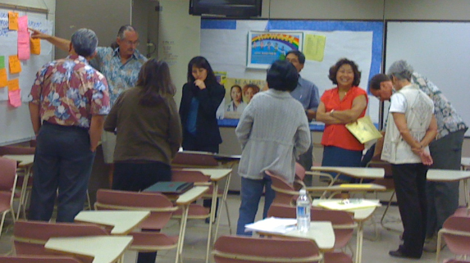
Our Roles as Stewards of Collaborative Excellence

Slide 2
Long-Range Development Plan
Strategic Plan 2008-2015
Self Evaluation (Accreditation)
Tactical Plan
Program Review

Slide 3
STUDENT
Engagement
Learning
Success

Slide 4
High Impact Educational Practices
Student Engagement
Student Learning
Student Success

Slide 5
High Impact Educational Practices
High Impact Educational Practices
Kahikoluamea Academic Academies
Satellite Nursing Programs
Sabbaticals
SLO and Course Level Assessment
Accelerating English 22 to 100
Gates Global Skills for Completion
C4Wards
Teaching Equivalencies
Faculty Vanguard Project
Laulima Training Academy
Vanguard
Math Emporium

Slide 6
STUDENT
Engagement
Learning
Success
Aligned Partnerships
Hawai‘i Graduation Initiative
Achieving the Dream
Performance Based Budgeting
Program Change Requests
Title III
Perkins Funding
National Science Foundation

Slide 7
Planning
Budgeting
STUDENT
Engagement
Learning
Success
High Impact Educational Practices
Assessment
Aligned Partnerships

Slide 8
Kapi‘olani Vision - 2008-2015
Kapi‘olani Community College prepares students for lives of:
Critical inquiry
Effective engagement and leadership in careers
Which strengthen the health, wellbeing and vitality of
  The individuals, families and communities that support all of us
  The cultural traditions that shape and guide all of us
  The land and sea that sustain all of us

Slide 9
Native Hawaiian Educational Attainment
Position the College as a leading indigenous-serving higher education institution

Slide 10
Increase Hawai‘i’s Educational Capital
Increase the participation and degree completion of students, particularly from underserved regions

Slide 11
Economic Contribution to the State
Provide a solid return on the State’s investment in higher education through research and training

Slide 12
Globally Competitive and Collaborative Workforce
Address critical workforce shortages and prepare students for effective engagement and leadership in a global environment.

Slide 13
Resources and Stewardship
Recognize and invest in faculty and staff resources and develop innovative and inspiring learning environments in which to work.

Slide 14
Resources and Stewardship
Exercise exemplary stewardship over public and private resources for a sustainable future.

Slide 15
Strategic Plan
Student
Success
Program Review
Tactical Plan

Slide 16
Sustainable Continuous Quality Improvement

Slide 17

Getting There
(Tactical Plans)
Specific actions to achieve student engagement, learning … and success

Slide 18
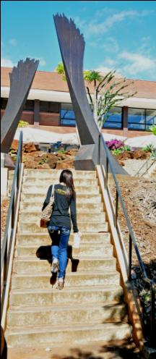
Progress
(Program Review)
Awareness
Development
Proficiency
Sustainable Continuous Quality Improvement

Slide 19

Success Depends on Every One and Everyone

Slide 20

Supporting Excellence
Inside and Outside of the Classroom
Notes:
We are committed to being a learning college. That means putting learning & student success first. We should ask ourselves, at all our decision points:
HOW does what I do support or promote or improve student success?
HOW does what I do support the college’s achievement of its strategic outcomes?
HOW do I know that what I do is actually working?
In all our endeavors, we need to address these fundamental questions. The same is true of professional development initiatives, of which there are many. Some are ongoing activities, some are newer initiatives. All are ways that faculty and staff can be stewards of collaborative excellence:

Slide 21
Sabbaticals
Eight sabbaticals approved for 2010-11
Notes:
Even in these challenging economic times, the College has continued to support sabbaticals. Eight were approved for this year, 2010-2011. Six of those were half-year, full-pay. In reviewing sabbatical applications, we ask the same questions:
WHAT are the expected outcomes?
HOW do these outcomes support learning and support the college’s attainment of its strategic outcomes?
We offer our congratulations to those faculty selected for sabbatical leave.

Slide 22
Teaching Equivalencies
(AKA “Assigned Time”)
Twenty-four faculty leaders compensated to provide leadership on course-level assessment
Notes:
Last year, the college dedicated over $200K to support faculty working to make contributions to Kapiolani outside of their primary responsibilities. Through such endeavors, the faculty contribute directly to excellence in the institution. When we provide this kind of support, we ask that faculty reflect on the outcomes they expect from their endeavors, want to know how their activities support learning and the college’s strategic outcomes, and seek insight into the ways that they know that they were effective.
This semester, the College is proving extra support for course-level assessment. Coordinated by Kristine Korey-Smith, 24 faculty will be working with colleagues to assess competencies in multi-section courses.
Will the assessment coordinators please stand to be recognized?

Slide 23

Enhancing Learning through Technology
COMING SOON:
Distance Learning Academy
Elluminate Live! virtual classrooms/offices
Protecting Personal Information Task Force workshops
Notes:
The College has committed to putting 30% of its classes online by 2015. We’re half-way there. To support faculty who want to engage in online teaching, CELTT has designed a program to assist. So far, the Laulima-focused academy has been offered twice, with over 50 faculty now trained.
How do we know the training works? Success rates in online classes have improved over time. Whereas student success in online courses once trailed the equivalent face-to-face class, as of Spring 2010, student success in online courses now EXCEEDS equivalent on-campus classes. A new web-based orientation for online learners makes it possible for students to hit the ground running, persist, and succeed.
Many continuing and new initiatives will be rolled out this semester by the CELTT team. Mary Hattori and the CELTT staff, congratulations on your successful efforts. Please stand to be recognized.

Slide 24

Curriculum Central
Click for Review
(January 31)
Click for Approval
(February 14)
Notes:
Faculty stewardship of excellence is reflected most significantly in curriculum design and development. It is the heart of the institution. To promote thoughtful and timely review of curriculum, the Curriculum Committee proposes a new two-step process, with two separate deadlines: January 31 “Click for Review” and February 14 “Click for Approval.”
The new two-step system breaks the existing process into two easier-to-manage steps which first involves the input of existing course information into Curriculum Central. This is followed by the review of the actual curriculum. Training sessions will be provided and special one-on-one support is available from Susan Pope.
Susan Pope and Curr Comm Chair Susan Dik, please stand.

Slide 25
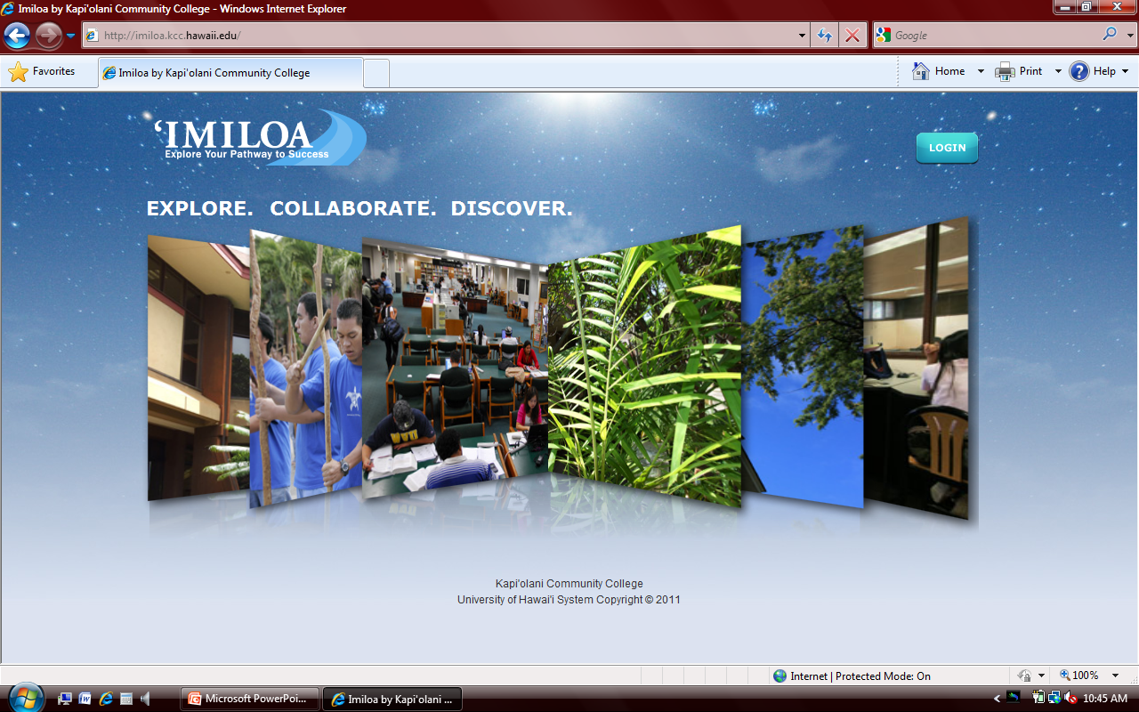
Pathway Academies
IMILOA
Notes:
First-Year Academies are intentional curricular structures designed by faculty which tie courses together in clusters. Funded by Title III, these Academies draw upon innovative pedagogies and proven educational practice and provide support to seamlessly acculturate students into the College and ultimately transition them into their second year.
FY Academies were piloted in 2009 for students majoring in Business, Hospitality, and the Culinary Arts. Early assessment of student success data has provided valuable lessons for next Fall’s Academies for incoming Arts & Sciences students. Three place-based and contextualized themes – Mālama ‘āina, Mālama Honua, and Mālama Kahi I Ke Kahi – will provide a cultural and learning context for first-year Native Hawaiian and other students.
FY Academies draw on the best and newest technological tools – including the KCC-designed and managed ‘Imiloa website – providing students with yet another layer of support.
Faculty and staff involved in the CTE Academies and A&S Academies, please stand. Mahalo for your stewardship on this important venture.

Slide 26
C4wards
Communities of Practice
Collaborative Circles for Creative Change
Notes:
Collaborative Circles for Creative Change, or C4wards, are facilitated professional development experiences which seek to engage faculty and staff in dialogue which addresses a concern or a shared passion in supportive, deeply collaborative ways. Built on the literature of “communities of practice,” “learning communities,” and our own experiences here at KCC, C4wards are deeply intentional, collaborative, and cooperative experiences which transcend the typical and more traditional professional development structure.
Supported by Title III and the Wo Foundation, C4wards are a signature KCC program, and each has the potential to magnify the impact of our current professional development work and extend its life – profoundly impacting students, individuals, and the institution as a whole over an extended period of time.
Each C4ward is led by a trained “concierge” who convenes, facilitates, and helps focus and support the work of its participants. Will our C4ward concierge faculty and staff please stand to be recognized? Note the kukui nut lei that they are wearing. These “concierge” are another excellent example of collaboration and leadership for excellence. A list of current C4wards is posted by the doors and new members are being welcomed into most.

Slide 27
Vanguard
Faculty
Initiative
Notes:
In the Vanguard Initiative, faculty from all areas – particularly those teaching high-enrolled and difficult subjects, have committed to redesigning their courses to improve student success. Funded by Title III, Achieving the Dream, and President Obama’s ARRA stimulus funds, Vanguard Faculty will engage in an introspective process in which they study and reconsider pedagogy, content, delivery, and assessment. Their work draws upon proven and innovative strategies to directly impact overall student success with a special eye towards the needs of our Native Hawaiian learners.
The Vanguard faculty will also participate in a C4ward, with Leigh Dooley as concierge. They will meet over the semester to learn together AND from each other.
Congratulations to those faculty selected as Vanguard Faculty. Fall and Spring Vanguard Faculty, please stand to be recognized.

Slide 28
Collaborative Excellence
Notes:
These and other initiatives are only a few of the many, many important collaborations occurring within the Kapiolani community. We have to remind ourselves, though, that collaborative excellence can only occur IF and WHEN we have all of our ducks in a row.
Our thanks to all of you for the work that you do in the continued quest for excellence. Have a great semester!

Slide 29
Operating Fund Request
Part 1 - The Hawai‘i Graduation Initiative
Increases undergraduate, graduate and professional degrees and certificates awarded by 25% (2008—2015)
  Funding based on outcome measures:
  Increase in enrollment
  Increase in transfer from 2 to 4 year campuses
  Increase in number of graduates
  Baseline data for enrollment will be census data Fall 2010 compared to Fall 2011
  Baseline data for transfer and graduation will be AY 2009–10 compared to AY 2011–11

Slide 30
Operating Fund Request
Part 2: Performance‐based Program Change Requests (PCRs) Kapi‘olani’s Requests
  Curricular and Professional Development Programs by Applying Emerging Technologies
    2.00 positions $120,688
  Hawai‘i Accelerated Graduation Institute in STEM
    2.00 positions $108,888
  Center for Distance Education Learning and Technical Assistance (DELTA)
    3.00 positions $175,412

Slide 31
Facilities Renovations
‘Iliahi first floor – completed
Mānele – completion end of January
Naio & Kopiko
  Design to be completed January 2011
  Bid February 2011
  Construction to begin March
Koki‘o – Phase II
  Bid award January 2011
  Construction to begin February 2011

Slide 32
Equipment Replacement
Chancellor Richards has allocated $ 2 million from our tuition and fees special fund for upgrade in instructional equipment across all programs.
Equipment requests were solicited in August through the department chairs.
The list was reviewed and prioritized by the Vice Chancellors and Deans.
Allocations were made for purchase of specific equipment in each department

Slide 33
Our Roles as Stewards of Collaborative Excellence
Ways to collaborate …
  Constituent-based governance groups …
  Advisory Councils
  Individual communication and participation

