Slide 1
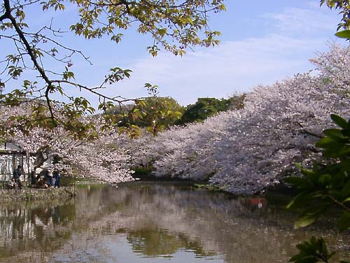
Early Modern Japan
1600 - 1853

Slide 2
The 47 Ronin (Chushingura)
April, 1702
Characters
Lord Asano - a country samurai
Lord Kira - retainer of the Shogun, protocol officer
Tokugawa Tsunayoshi - Shogun
Oishi Kuranosuke - leader of the 47 Ronin, Samurai

Slide 3
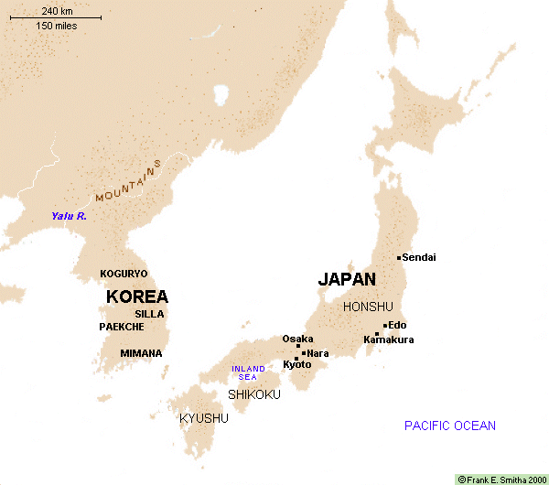
Japan In the Middle Ages

Slide 4
The Tokugawa Shogunate
Win at Sekigahara in 1600
Shogun in 1603
Provides legitimacy
Emperor’s right-hand man
Handles temporal affairs to free emperor to deal with spiritual affairs
Confucian Moral Economy - Modified
Centralized Feudalism

Slide 5
Emperor’s Right Hand Man
Emperor has traditionally reigned, but not ruled
Divine figure who is too busy with spiritual affairs to deal with running a kingdom.
In reality, a symbiotic relationship:
Emperor gets an allowance
Shogun gets legitimacy & right to make laws

Slide 6
Confucian Moral Economy
Warriors
Shogun
Daimyo
Samurai
Farmers
Artisans
Merchants

Slide 7
Centralized Feudalism
Baku-Han system
Bakufu (Shogunate) rules all
Han are autonomous domains
Subject to Shogunal law in some respects
Limit on castles
Marriages must be approved by the Shogun
Organized in concentric circles around Edo
Alternate Attendance

Slide 8
The “modern” in Japan
All this suggests a move toward the “modern”
Move toward rule of law
Move toward a centralized, bureaucratic government, rather than Feudalism
Still some premodern elements
remains of feudalism
Personal loyalty

Slide 9
Edo: 18th Century

Slide 10
Social Divisions
1. Samurai (lit. “those who serve)
2. Farmers
3. Chonin (Townsfolk)
Artisans
Merchants

Slide 11
Samurai

Slide 12
Lifestyle
Music
Slow, Focused
Temple Instruments
Poetry
Waka, Tanka
Art:
Kanno School
Homes & Armor

Slide 13
Samurai Music
Slow
Shakuhachi
Shamisen
Small-size
Zen Feel
Koto

Slide 14
From Hidden Behind Leaves
“The way of the warrior (bushido) is to find a way to die. If a choice is given between life and death, the samurai must choose death. There is no more meaning beyond this. (1716)

Slide 15
Poetry & Literature
Noh Drama
Waka & Tanka Poems
Introspective
Death Poems
Tale of the Heike
Haiku
Chrysanthemum
silence - monk
sips his morning tea

Slide 16
Samurai Tanka
There is no leisure in a life of indolence
That should be left to the birsds and the bees
There is seclusion even in a crowd
Tranquility in the streets of a town
The mountain clouds are free from worldly attachments
They come and go of themselves
How can the place to bury one’s bones
Be limited to the green mountains?

Slide 17
Samurai Art
Symbolic of Power
Expensive
Traditional
Kanno School

Slide 18
Armor
Practice every day
Armor reactive
Not static
Weapons
Sign of status

Slide 19
Himeji Castle

Slide 20
Farmers

Slide 21
Farmer Music
Folk styles
Voice only
Shamisen, kokyu

Slide 22
Farmer’s Lives
Clothing
food
1643 - “Concerning farmers’ clothing
in accordance with the previous
bakufu edict, the village headman
and his family may wear silk,
pongee, linen, and cotton. Lower
village officials may only wear
linen or cotton. . .

Slide 23
Chonin

Slide 24
Chonin Life
Lowest Station
Most money & time
Music
Art
Drama
Literature
Activities

Slide 25
Chonin Music
Koto, Shamisen, Shakuhachi, Voice
Parlors of wealthy
More energy
Blend of peasant & samurai forms

Slide 26
Chonin Art
Ukiyo-e
Centered on pleasure quarters
Lively, colorful
Encompassed many subjects
pleasure
business
religion

Slide 27
Drama: Kabuki
Kabuki
Okuni temple dances
move to male-only actors
atmosphere in the theater
fame of actors

Slide 28
Sharaku Print

Slide 29
Utamaro Print

