Slide 1
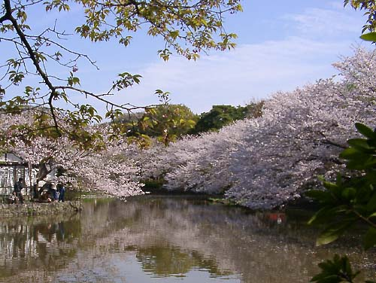
Early Modern Japan
1600 - 1853

Slide 2
The 47 Ronin (Chushingura)
April, 1702
Characters
  Lord Asano - a country samurai
  Lord Kira - retainer of the Shogun, protocol officer
  Tokugawa Tsunayoshi - Shogun
  Oishi Kuranosuke - leader of the 47 Ronin, Samurai

Slide 3
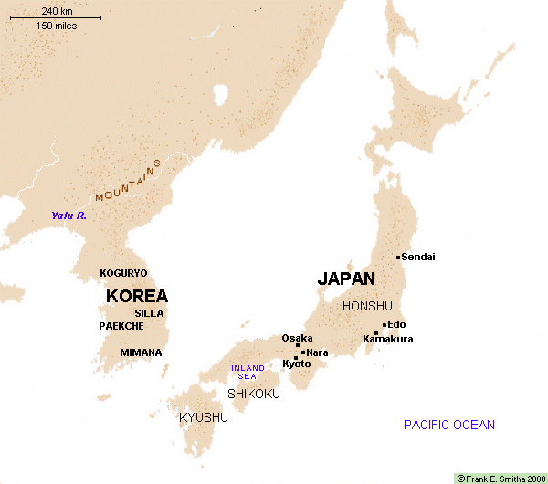
Japan In the Middle Ages

Slide 4
The Tokugawa Shogunate
Win at Sekigahara in 1600
Shogun in 1603
  Provides legitimacy
    Emperor’s right-hand man
    Handles temporal affairs to free emperor to deal with spiritual affairs
Confucian Moral Economy - Modified
Centralized Feudalism

Slide 5
Emperor’s Right Hand Man
Emperor has traditionally reigned, but not ruled
  Divine figure who is too busy with spiritual affairs to deal with running a kingdom.
In reality, a symbiotic relationship:
  Emperor gets an allowance
  Shogun gets legitimacy & right to make laws

Slide 6
Confucian Moral Economy
Warriors
  Shogun
  Daimyo
  Samurai
Farmers
Artisans
Merchants

Slide 7
Centralized Feudalism
Baku-Han system
  Bakufu (Shogunate) rules all
  Han are autonomous domains
    Subject to Shogunal law in some respects
      Limit on castles
      Marriages must be approved by the Shogun
      Organized in concentric circles around Edo
      Alternate Attendance

Slide 8
The “modern” in Japan
All this suggests a move toward the “modern”
  Move toward rule of law
  Move toward a centralized, bureaucratic government, rather than Feudalism
Still some premodern elements
  remains of feudalism
  Personal loyalty

Slide 9
Edo: 18th Century

Slide 10
Social Divisions
1. Samurai (lit. “those who serve)
2. Farmers
3. Chonin (Townsfolk)
  Artisans
  Merchants

Slide 11
Samurai

Slide 12
Lifestyle
Music
  Slow, Focused
  Temple Instruments
Poetry
  Waka, Tanka
Art:
  Kanno School
Homes & Armor

Slide 13
Samurai Music
Slow
Shakuhachi
Shamisen
  Small-size
Zen Feel
Koto

Slide 14
From Hidden Behind Leaves
“The way of the warrior (bushido) is to find a way to die. If a choice is given between life and death, the samurai must choose death. There is no more meaning beyond this. (1716)

Slide 15
Poetry & Literature
Noh Drama
Waka & Tanka Poems
  Introspective
Death Poems
Tale of the Heike
Haiku
Chrysanthemum
silence - monk
sips his morning tea

Slide 16
Samurai Tanka
There is no leisure in a life of indolence
That should be left to the birsds and the bees
There is seclusion even in a crowd
Tranquility in the streets of a town
The mountain clouds are free from worldly attachments
They come and go of themselves
How can the place to bury one’s bones
Be limited to the green mountains?

Slide 17
Samurai Art
Symbolic of Power
Expensive
Traditional
  Kanno School

Slide 18
Armor
Practice every day
Armor reactive
  Not static
Weapons
  Sign of status

Slide 19
Himeji Castle

Slide 20
Farmers

Slide 21
Farmer Music
Folk styles
  Voice only
  Shamisen, kokyu

Slide 22
Farmer’s Lives
Clothing
food
1643 - “Concerning farmers’ clothing
in accordance with the previous
bakufu edict, the village headman
and his family may wear silk,
pongee, linen, and cotton. Lower
village officials may only wear
linen or cotton. . .

Slide 23
Chonin

Slide 24
Chonin Life
Lowest Station
Most money & time
  Music
  Art
  Drama
  Literature
  Activities

Slide 25
Chonin Music
Koto, Shamisen, Shakuhachi, Voice
  Parlors of wealthy
More energy
Blend of peasant & samurai forms

Slide 26
Chonin Art
Ukiyo-e
  Centered on pleasure quarters
  Lively, colorful
  Encompassed many subjects
    pleasure
    business
    religion

Slide 27
Drama: Kabuki
Kabuki
  Okuni temple dances
  move to male-only actors
  atmosphere in the theater
  fame of actors

Slide 28
Sharaku Print

Slide 29
Utamaro Print

